Slide 1

2024 HESNI Annual Conference
Thursday May 2, 2024
ASHRAE/ASHE Guideline 43P Is On The Way– Wanna’ Know What’s Coming?
Notes:
Hear about the evolution, current state and (more importantly) where these guidelines that define air quality appear to be heading. Our presenters, both of whom serve in ASHRAE's Technical Committee TC 9.6, will address published errata, currently approved addenda (some still in the approval process), and a host of "requests for interpretations" received by TC 9.6.
From Larry’s email to Don Doherty:
He and I will present details of the standard including its’ evolution and, more importantly, where it’s headed. We’ll address published errata, currently approved addenda, a few addenda in process and a whole host of “requests for interpretations” that TC 9.6 processes. I’ve attached a recent slide deck from a Midwest ASHE presentation I made with a Client of mine so you can see the “bones” of what the presentation would include.

Slide 2
Guideline 43 – Agenda
Introduction
ASHRAE Standard 170
Guideline 43 – why needed?
Guideline 43
Summary
Questions

Slide 3

Laurence V. Wilson, PE, ASHRAE HFDP
BSME, University of Illinois at Urbana-Champaign
Analyses and Design/Construction: 42 years
Healthcare & Lab Projects (New + Renovation)
NSPE, ASHRAE, ASHE, MWHCEC, HESNI, NFPA, ASPE
ASHRAE:
    Voting Member ASHRAE TC 9.6—Health Care
    Corresponding Member ASHRAE Standard 170
    Excellence in Engineering Awards (Judge for IL Chapter)
    Excellence in Engineering Awards (won multiple times at the local, regional and national levels)
    Published in the ASHRAE Journal
  ASHE PDC, MWHCEC and HESNI
    Presented multiple times at the local, regional and national levels
Notes:
Degreed, Licensed Mechanical Engineer Not needed: PE
40 Years of Projects—Major in HC, Minor in Labs
Analyses and Design/Construction: 40 years
50/50 Split—New vs. & Renovation Healthcare & Lab Projects
Member ASHE, HESNI, ASHRAE, ASPE, NSPE, NFPA
Voting Member ASHRAE TC 9.6—Health Care
Corresponding Member ASHRAE of TC 9.6 Sub-Committee on Standard 170
Judge: for ASHRAE-IL Excellence in Engineering Awards Program
Presenter at ASHE PDC, MWHCEC and HESNI

Slide 4

Kenneth A. Monroe, PE, MBA, CHC, PMP
25+ years in Healthcare “Bricks and Mortar
  Construction
  Operations and Maintenance
  Compliance: The Joint Commission
ASHRAE
  Standards Committee
  Standard 170 Committee / Guideline 43
  Standard 202 Committee - Commissioning

Slide 5

Which Came First--the Chicken or the Egg?
PDCCx == Standard 170
O/M == Guideline 43
FACILITY LIFE CYCLE - Which Came First—Planning/Design/Construction/Cx (PDCCx)
or Operations & Maintenance (O/M)?
Notes:
First jointly sponsored standard by ASHRAE and ASHE - 2008!
Consensus standard is “continuous maintenance”by ASHRAE Standing Standard Project (SSP) Committee 170 and Technical Committee 9.6 – Health Care Facilities
continuous maintenance = continuous improvement
Written so easily invoked by AHJ’s

Slide 6
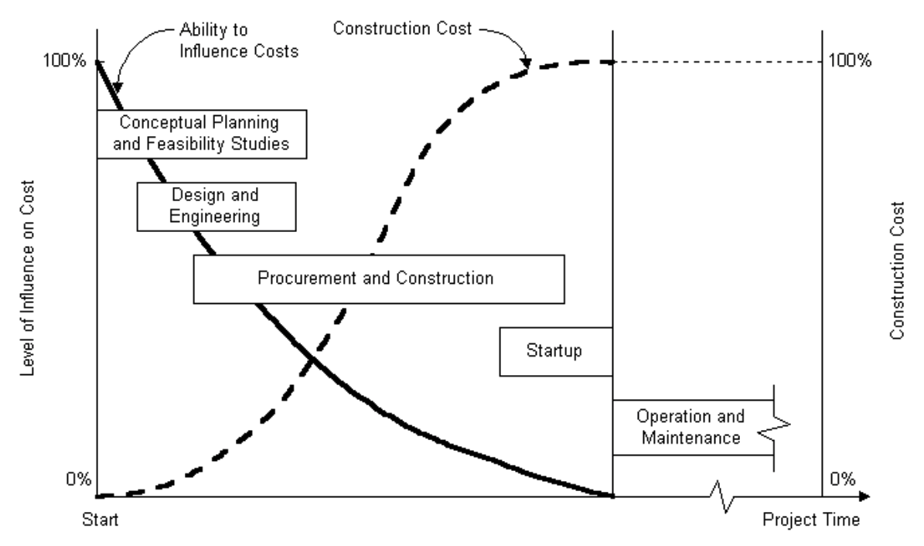
Seems Linear, Right? PDCCx followed by O/M. Unh unh!!

Slide 7

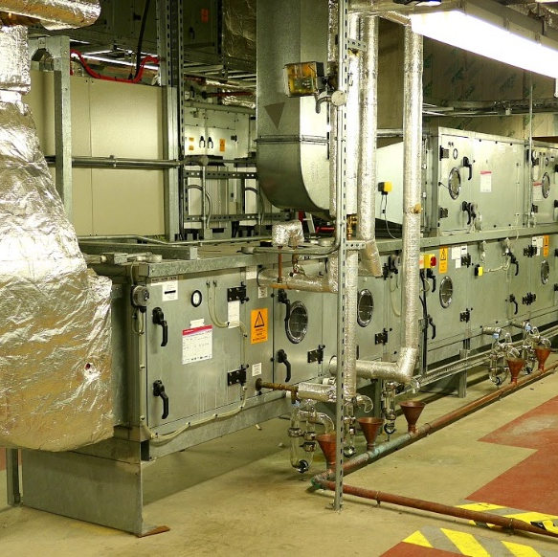
Example: Duty/Standby AHU’s for a Surgical Suite
Planning involves considering O/M (i.e. space needs, access for PM’s/repairs/overhauls/replacement, reducing fan energy, reliability, etc.)
Design involves considering O/M (i.e. sequence of operation, spare parts storage/shop areas, housekeeping pads, acoustics, source of normal and essential power,HVAC system service area maps, vent schedules, etc.)
Construction involves considering O/M (i.e. proper installation, provision of access doors in ductwork for cleaning and inspection, good workmanship at filter frames, prep of accurate submittals, prep of good O/M manuals, etc.)
Commissioning involves O/M (i.e. proper startup to ensure warranty remains intact, benchmarking performance for later use during troubleshooting, integrated systems testing, etc.)
P
O
D
C
M
Cx

Slide 8
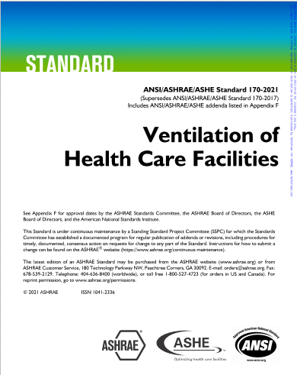
Standard 170-2021 edition--Title
First jointly sponsored standard by ASHRAE and ASHE – 2008.
Updated 2013 and 2017.
Current edition – 2021.
Next edition – 2024.
Consensus standard (AHJ, O, A, E, C, ACCR, etc.)
“continuous maintenance" equals “continuous improvement"
Written so it can be easily invoked by AHJ’s
Notes:
First jointly sponsored standard by ASHRAE and ASHE - 2008!
Consensus standard is “continuous maintenance”by ASHRAE Standing Standard Project (SSP) Committee 170 and Technical Committee 9.6 – Health Care Facilities
continuous maintenance = continuous improvement
Written so easily invoked by AHJ’s

Slide 9

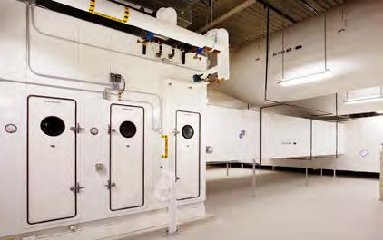
Standard 170-2021 edition--Purpose
Purpose is to define HVAC system design requirements that provide environmental control in health care facilities

Slide 10



Standard 170-2021 edition--Scope
Applies to patient care areas, resident care areas and related support areas within (aligns w/ FGI now):
Hospitals
Outpatient Facilities
Nursing Facilities

Slide 11

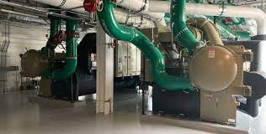
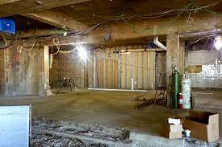
Standard 170-2021 edition--Scope
Applies to these kinds of projects:
New buildings including additions
Renovations/alterations of existing buildings
Infrastructure upgrades

Slide 12
Standard 170-2021 edition--Scope
Considers:
Contamination from non-viable particulates
Chemical, biological (viable-virus, bacteria), but not radiological (CBR)
VOC’s (read: odor)
Aseptic environmental
Dry bulb temperature and relative humidity
Airflow rates (supply, outdoor, exhaust)
Not thermal comfort

Slide 13
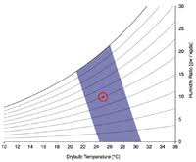
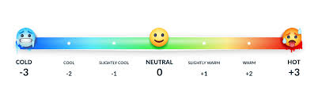
Standard 170-2021 edition--Scope
Compliance with ASHRAE Standard 170 does not guarantee compliance with ASHRAE Standard 55--Thermal Comfort (Tdb, Tmrt, RH, draft)
Compliance with ASHRAE Standard 170 does not guarantee compliance with ASHRAE Standard 62.1---Acceptable Indoor Air Quality

Slide 14
Standard 170-2021 edition--Sect 11.0—Normative References
Normative = part of the standard which means that these references contain requirements necessary to conformance with Standard 170
  ASHRAE Standard 62.1-2019 Ventilation for Acceptable IAQ
  a. While Section 8.0 within 62.1-2019 specifically addresses “Operations and Maintenance”, there are no specific references within Standard 170-2021 that point to Standard 62.1-2019 as it relates to “Operations and Maintenance”.
  b. Having said that, Section 8.0 within 62.1-2019 does require an O&M manual be developed for all buldings’ ventilation systems which must include some very specific and prescriptive tasks—not negotiable—therefore, additive to Guideline 43!

Slide 15
Informative References
Informative = not part of the standard.
Standard 170--Appendix A—Operations & Maintenance (O&M) Procedures
    A1---O&M in HC Facilities
    --recommendations related to pressurization of OR’s, AII rooms and PE rooms plus filter maintenance plus unoccupied turndown RH levels <= 60%
    A2---Special Maintenance for HVAC Units
    --recommendations for FCU’s, HP’s, Heating Elements and Fan-Powered Terminal Units
    A3---Outdoor Air Intakes for Below Grade Areaways
    --clarification via graphic related to dimensional cited in the text of the standard proper

Slide 16


Remember the Building Life Cycle!!
Let’s transition
from
Standard 170
to
Guideline 43
with a shift to
Operations & Maintenance

Slide 17
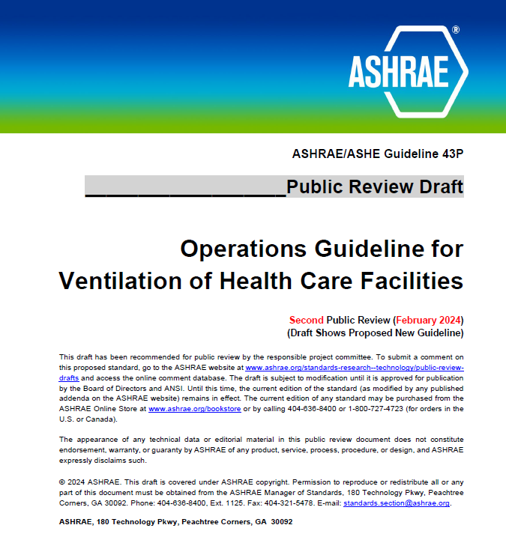

Slide 18
Design verses Operations
Temperature in the Intensive Care Unit
  Is there a difference in the temperature designed requirement than the way the temperature is maintained within an ICU?
Design Requirement
  70⁰ - 75⁰ F (21⁰ – 24⁰ C)
  Rh 30-60%
Operations Requirement
  CDC based on AIA guidelines, 2001 edition
  Same as above
  OSHA
    OSHA has no regulations specifically addressing temperature and humidity
    General Duty Clause - free from recognized hazards
    Recommends 68 – 76 F (20⁰ – 24⁰ C) Rh 20-60%

Slide 19
Design verses Operations
Excursions
  Is there a difference in the design requirement than the way excursions are managed during operations?
Design Requirement – Set requirements or ranges to be designed to
  Prevent nuisance alarms
  Short term excursions allowed
  “Clinical Need”
Operations Requirement
  Things happen
  Need to be able to address excursions
  Aging equipment

Slide 20
ASHRAE/ASHE Guideline 43
Operations Guideline for Ventilation of Health Care Facilities
  Challenges:
    Unclear / conflicting standards and guidelines established by a variety of professional organizations.
    ASHRAE/ASHE 170, Ventilation of Health Care Facilities - design standard that not apply to operations but still applied as an operational standard
  During Surveys, misunderstandings led to a great deal of confusion and even conflict
  Guideline 43 is an operational guideline that will work in collaboration with ASHRAE/ASHE 170,
  The Guideline recommends a maintenance ventilation management program (VMP) based on the risk of harm categorized as either critically or non-critically ventilated spaces.
  Guideline lists the recommended inspection and maintenance tasks for ventilation systems within health care facilities.
Notes:
Foreward:
Health care organizations are challenged to meet a series of unclear and sometimes conflicting heating, ventilating, and air-conditioning (HVAC) standards and guidelines established by a variety of professional organizations. Making the situation more difficult is that some standards like ASHRAE/ASHE 170, Ventilation of Health Care Facilities, are design standards that do not apply to operations but are applied as an operational standard by authorities having jurisdiction. Also complicating the issue is the enforcing of differing versions of the various standards at different instances in the building lifespan.
When hospital and ambulatory care organizations are surveyed by state agencies, Centers for Medicare & Medicaid Services (CMS), and other accrediting organizations, misunderstandings about the major difference between building and engineering design standards and operational practice guidelines have led to a great deal of confusion and even conflict in the health care physical environment. Guideline 43 was created in a collaborative effort between ASHRAE and the American Society for Health Care Engineering (ASHE) with the intent of addressing the often-inconsistent practice of applying HVAC design standards to operational practices in health care facilities.
The intent of Guideline 43 is to provide an operational guideline for health care facilities that will work in collaboration with the design standard ASHRAE/ASHE 170,
The purpose of the Guideline is to address health care HVAC systems as a comprehensive whole while also providing consistency in the maintenance and operations of these systems.
The Guideline recommends a maintenance ventilation management program based on the risk of harm categorized as either critically or non-critically ventilated spaces.
Finally, the Guideline lists the recommended inspection and maintenance tasks for ventilation systems within health care facilities.

Slide 21
ASHRAE/ASHE Guideline 43
Operations Guideline for Ventilation of Health Care Facilities
  Purpose: to provide recommendations for the operations of heating, ventilation and air conditioning (HVAC) systems that provide environmental control in health care facilities for the safety and comfort of health care facility occupants
  Scope: The operation of health care facility HVAC systems and equipment, their normal and routine maintenance, major tasks of periodic maintenance, and energy conservation
    Describes acceptable ranges
    Does not cover DESIGN of facilities – see ASHRAE/ASHE Standard 170
    All healthcare
    Monitored spaces
    Ranges
    Emergency Operations.

Slide 22
ASHRAE/ASHE Guideline 43
Section 3 – Definitions
DRT – Decision and Response Team
  Responsible for creating VMP
VMP – Ventilation Management Plan
  Similar to Water Management Plan
  Overarching Philosophy
  Part of Utility Management Program
  Explains HOW of Maintenance
  Includes Inventory

Slide 23
ASHRAE/ASHE Guideline 43
Section 4: Operating Practices (Section 6 in First Public Review)
  Consistently balance at minimum day-to-day unscheduled outages or repairs
  Scheduled regulatory and maintenance needs
  Ongoing building rehabilitation and construction projects
  Long-term visioning and capital planning
  Baseline practices for ensuring optimal performance

Slide 24
ASHRAE/ASHE Guideline 43
Section 4: Operating Practices
  Reference and Planning Documents
    Record Files
      As-Builts
      Commissioning Documents
      O & M Manuals
      Warranties
    Consolidated/Master Files
      HVAC Zone Maps
      VMP – Ventilation Management Plan
  Utility Procurement
  CMMS records

Slide 25
ASHRAE/ASHE Guideline 43
Section 4: Operating Practices
  Normal Operations
    Service Level agreements
    Communications
    VMP
  Maintenance Operations
  Excursion Response
  Emergency Operations
  Construction
    ICRA / PCRA / ILSM
  Infrastructure Capital Planning
    Equipment Lifecycle

Slide 26
ASHRAE/ASHE Guideline 43
Section 4.3 – On-going Surveys as TJC, IDPH
Inspection / Verification Documentation
Tasks
  On-Demand
  Regular/periodic inspections
Staff Roles / Org. chart.
Diagnostics and Monitoring
KPI data tracking
  Energy Consumption
  HAI / Infection Control

Slide 27
ASHRAE/ASHE Guideline 43
Section 5: Ventilated spaces are categorized based on risk of harm
  Critically Ventilated Spaces
    Those spaces used for invasive or high-risk procedures, infection control isolation, or any space where loss of required air flow, temperature, humidity, and/or pressurization could result in harm, injury or death to patients.
  Non-critically Ventilated Spaces
    Those spaces not used for invasive or high-risk procedure areas, not used for infection control isolation, and where loss of required air flow, temperature, humidity, and/or pressurization would not result in harm, injury or death to patients.
Notes:
The continued application of building management systems and computer maintenance management systems provides for advanced monitoring and verification of condition indicators throughout a facility is encouraged and can provide a more reliable and proactive response to excursions from established condition indicators.

Slide 28
ASHRAE/ASHE Guideline 43
Section 5: Verification of Space Conditions
  Prescribed Frequencies - Space environmental conditions should be physically verified for pressure, temperature, humidity, and airflow as in Tables 5.1-5.4.
  Risk-based management – Space testing and verification frequency should be based on reliability factors and facilities risk of failure with adjustments on:
    Critically of asset/equipment
    Age of equipment
    Function of equipment and variability
    Risk of failure based on equipment type
    Manufacturer requirements
    Frequency of preventative maintenance preformed
    Allocation/availability of spare parts and repair
    Past history of failure
Notes:
Use 1 of 2 approaches….

Slide 29
ASHRAE/ASHE Guideline 43
Section 5: Monitored Spaces
  Temperature & Humidity Testing Frequency
Function of Space | Humidity Baseline Testing Frequency
Wound intensive care (burn unit), Operating room, Operating/surgical cystoscopic rooms, Delivery rooms (caesarean), Procedure room, GI Endoscopy Procedure Room, X-ray (surgery/critical care & catheterization), Airborne Infection Isolation (AII) room, Combination AII/PE room, PE room, Critical and intensive care, Recovery room, Treatment room, Continued care nursery, Newborn nursery suite, Laser eye room, Newborn intensive care, Trauma room (crisis or shock), Patient room, Labor/delivery/recovery (LDR), Labor/delivery/ recovery/postpartum (LDRP), Intermediate Care, Emergency Department exam/treatment room, X-ray (diagnostic & treatment), General examination room, Special examination room, Triage, Treatment room, Physical therapy, ECT procedure room, Emergency Department public waiting room, Radiology Waiting Rooms, Medication room, Clean workroom, Sterile storage room | Daily

Slide 30
ASHRAE/ASHE Guideline 43
Section 5: Monitored Spaces
  Pressure Testing Frequency
Function of Space | Baseline Pressure Testing Frequency
Operating room, Operating/surgical cystoscopic rooms, Delivery rooms (caesarean), Procedure room, X-ray (surgery/critical care & catheterization), ED Trauma room, Neonatal Intensive Care, Wound Intensive Care (Burn Unit), Combination AII/PE room, PE room | Weekly
Airborne Infection Isolation (AII) room, Bronchoscopy, sputum collection, & pentamidine administration, ED Trauma/Resuscitation Room, Laser Eye Room, Triage Room, Anterooms, Clean workroom, Clean Supply Room, Clean Linen Storage, Sterile storage room, Laboratory work area media transfer, Pharmacy Services | Monthly
Emergency Department Decontamination, Autopsy Room, Non-Refrigerated body holding room, Instrument Processing Room | Annually
Emergency Department public waiting room, Medical/anesthesia gas storage, Radiology waiting, Toilet rooms, Darkroom, Dialyzer reprocessing room, Instrument Processing, Hydrotherapy, Laboratories, Nuclear medicine hot lab, Physical therapy, Sterilizer equipment room, Decontamination room, Bedpan room, Environmental Services Room, Laundry processing room, Linen and trash chute room, Soiled linen sorting and storage, Warewashing, Hazardous material storage, Regulated waste holding, Soiled workroom or soiled holding | Change of Use

Slide 31
ASHRAE/ASHE Guideline 43
Section 5: Monitored Spaces
  Air Flow Testing Frequency
Function of Space | Baseline Air Flow Testing Frequency
Operating room, Operating/surgical cystoscopic rooms, Delivery rooms (caesarean) | Annual
PE room, Airborne Infection Isolation (AII) room, Combination AII/PE room, Wound intensive care (burn unit) | Triennial
X-ray (surgery/critical care & catheterization), Procedure room, Bronchoscopy, sputum collection, & pentamidine administration, GI Endoscopy Procedure Room, Decontamination Room, Clean workroom, Sterile storage room | Change of Use

Slide 32
ASHRAE/ASHE Guideline 43
Section 6: Implementation (Section 4 in First Public Review)
  Define the responsible party for compliance
    Health care facility management organization
    Organizration may designate other authorized parties
  Develop a Ventilation Management Program plan (VMP)
    Appendix F
    Measurable and trended over time
  Define the elements of the program.
    Program Objectives
    Inventory
    Baseline Inspection and Maintenance Tasks
    Condition Indicators
  Other Considerations
    Operational Plan in the Event of Outages
    Unoccupied Turndown
    Revisions of the VMP
Notes:
The Implementation section outlines the implementation of Guideline 43 for healthcare building HVAC system owners, focusing on inspection and maintenance practices. It emphasizes a minimal maintenance program applicable to all healthcare facilities, with flexibility for owners to choose compliant means and methods. The responsible party is tasked with compliance, requiring the development of a ventilation management program plan and defining its elements. Legacy systems are evaluated based on the standards at the time of construction, with degraded performance meeting original requirements considered compliant. The section also covers the responsible party’s role, operation and maintenance plan requirements, and the need for continuous improvement through periodic reviews and revisions based on equipment condition and facility changes.
VMP: The multidisciplinary team will develop a plan ensuring HAC systems can provide thermal comfort and indoor air quality in an energy efficient manner. The plan should include operational components and condition indications by space function.

Slide 33
ASHRAE/ASHE Guideline 43
Section 6: Implementation
  Legacy Systems (6.6)
    Use the design standard in place at time of construction
    If staff desire a modified operating range, it is acceptable to update the range provided that the system is capable and the new range is documented in the VMP
    EXAMPLE: Staff desires for operating rooms to have a range of 64⁰-78⁰ F, with a typical setpoint of 64⁰ F. The legacy system is capable of meeting the modified range. After updating the VMP, this modified temperature range is acceptable.
Notes:
Legacy systems, which are those systems which may have been design under a previous design standard or code at the time of construction, will also be included in the VMP plan. The intent is to ensure that the legacy systems are operating under the conditions for which they were designed. The VMP will document the operating parameters of the legacy systems

Slide 34
ASHRAE/ASHE Guideline 43
Condition Indicators – 6.3.2.3
Physical Condition
Observed during inspections and compared
  Monitored over time
Reference: Appendix A

Slide 35
ASHRAE/ASHE Guideline 43
Section 6: Implementation – Section 6.7 - Turndown
  Reference: Standard 170
  Document
    Includes Locations and Settings
Notes:
Similar to legacy systems, the VMP plan also outlines how to address excursion variations. Excursion variations are omitted from design guidelines furthering the need for an operational guideline. The guideline does not indicate specific parameters for temperature, relative humidity and pressure relationship excursions, but rather gives ranges and recommended thresholds for responses. It is up to the institution to decide and determine the excursion limits with their internal key stakeholders

Slide 36
ASHRAE/ASHE Guideline 43
Section 6: Implementation – Section 6.8
  Excursion Variations
    Under certain conditions, the system output will vary from the VMP condition indicators.
      Establish a response process
      Based on a risk assessment process
      Use of a multidisciplinary team to develop
      Develop recommended protocol
      Include a decision response team
    Relative Humidity
    Temperature
    Pressurization Relationship
Notes:
Similar to legacy systems, the VMP plan also outlines how to address excursion variations. Excursion variations are omitted from design guidelines furthering the need for an operational guideline. The guideline does not indicate specific parameters for temperature, relative humidity and pressure relationship excursions, but rather gives ranges and recommended thresholds for responses. It is up to the institution to decide and determine the excursion limits with their internal key stakeholders

Slide 37
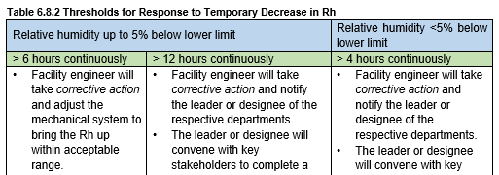
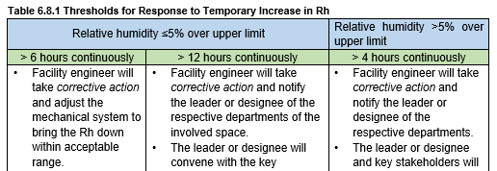
ASHRAE/ASHE Guideline 43
Section 6: Implementation
  Excursion Variations
    Recommended Actions
Notes:
For example of items the team should considering when deciding to continue or halt a procedure in the event of unresolved non-compliant humidity conditions:
• Risk of fire and effect on equipment calibration during low humidity conditions
• Presence of condensation and moisture in the environment and sterile and non-sterile supplies during extended high humidity conditions
• Ability to maintain aseptic practices
• Infection risk to patients undergoing procedures• Level of comfort of the clinical staff and patients
• The timeliness of the resolution
• Risk to patients impacted by the potential delay in care
• Availability of alternate location for procedures.
This also highlights the need for a multidisciplinary team inclusive of infection prevention and control and regulatory representatives to assist in devising the response plans to each of the conditions

Slide 38
ASHRAE/ASHE Guideline 43
Section 6: Implementation
  Review and Revision of VMP
    Continuously improve the VMP
      Analysis of Control Indicators
      Equipment Condition
      Facility Changes
      New Technologies
    6.5 – Revise the VMP:
      Periodically review program
        Formal meetings
        Beginning and End of performance period

Slide 39
ASHRAE/ASHE Guideline 43
Section 7: Baseline Inspection and Maintenance Tasks
  Lists the baseline Inspection Tasks and Maintenance Tasks, as well as the Frequency and Corrective Actions
  Should modify the frequency of task, if warranted by analysis and/or identification of acceptable or unacceptable conditions
  BMS and CMMS provide for advanced monitoring and verification of condition indicators throughout a facility
    Encouraged and can provide a more reliable and proactive response to excursions from established condition indicators
  VMP should document monitoring and verification process for monitored spaces

Slide 40
ASHRAE/ASHE Guideline 43
Section 7: Baseline Inspection and Maintenance Tasks
Air Distribution Systems
  Air Handling Units/Roof-top Units
  Coils and Radiators
  Dehumidifiers
  Humidifiers
  Fans
  Unit Heaters
  Energy Recovery Units
  Terminal Units
  Ductwork and Diffusers
Central Systems
  Controls Systems
  Boilers
  Chillers
  Cooling Towers
  Control systems
  Boilers
  Chillers
  Cooling Towers
  Microturbines
  Hydronic Distribution Systems
  Steam Distribution Systems
  Pumps

Slide 41
ASHRAE/ASHE Guideline 43
Appendices
  Appendix A – Recommended System Condition Indicators (6.3.2.3)
  Appendix B – Sources of Program Objectives (6.3.2.4)
  Appendix C – Situations Requiring Review of the Maintenance Plan (6.5)
  Appendix D – Reasons for Adjusting Maintenance Task Frequency
  Appendix E – Facility Observations That May Influence Baseline Inspection Frequencies
  Appendix F – Ventilation Management Program Plan (6.3)

Slide 42
ASHRAE/ASHE Guideline 43
Current Status
  1st Public Review Complete and Revisions Made
  2nd Public Review Complete – comments being reviewed.
  Committee Vote at ASHRAE Summer Meeting in Indianapolis in June, 2024 for publication

Slide 43
Guideline 43 – Summary
Introduction
ASHRAE Standard 170
Guideline 43 – why needed?
Guideline 43

Slide 44


Questions?
Comments?

Slide 45


Lean on Your Presenters
Laurence V. Wilson
(630) 202-9003
larry.wilson@rtmec.com
Kenneth A. Monroe, PE, MBA, CHC, PMP
(708) 494-9717
kmonroe@dls.net

