Slide 1


Optimizing HVAC systems in the Healthcare environment
May 2, 2024
Mark Modera
Professor Emeritus – UC Davis
CHIEF SCIENTIFIC ADVISOR – Aeroseal
Joe St. Pierre
Business Development Manager- Aeroseal

Slide 2
Presentation overview
Large-building hvac research and development – Mark Modera
  Commercial Building procurement hub: CO₂ Sensors, Demand Control Ventilation (https://energyproductevaluations.org/)
  licensed uc davis Inventions: Aerosol building Sealing, Tracer-Gas Flow Testing
  Measuring Duct Leakage: Tracer-Gas version of ASHRAE Standard 215
  Comparison of Return Ductwork and Open Plenums
  Fan Energy versus Thermal Energy – IAQ Implications
DUCT LEAKAGE and Airside performance in HealthCare – Joe St. Pierre
  Energy waste in healthcare buildings
  Duct sealing methods
  Case studies

Slide 3
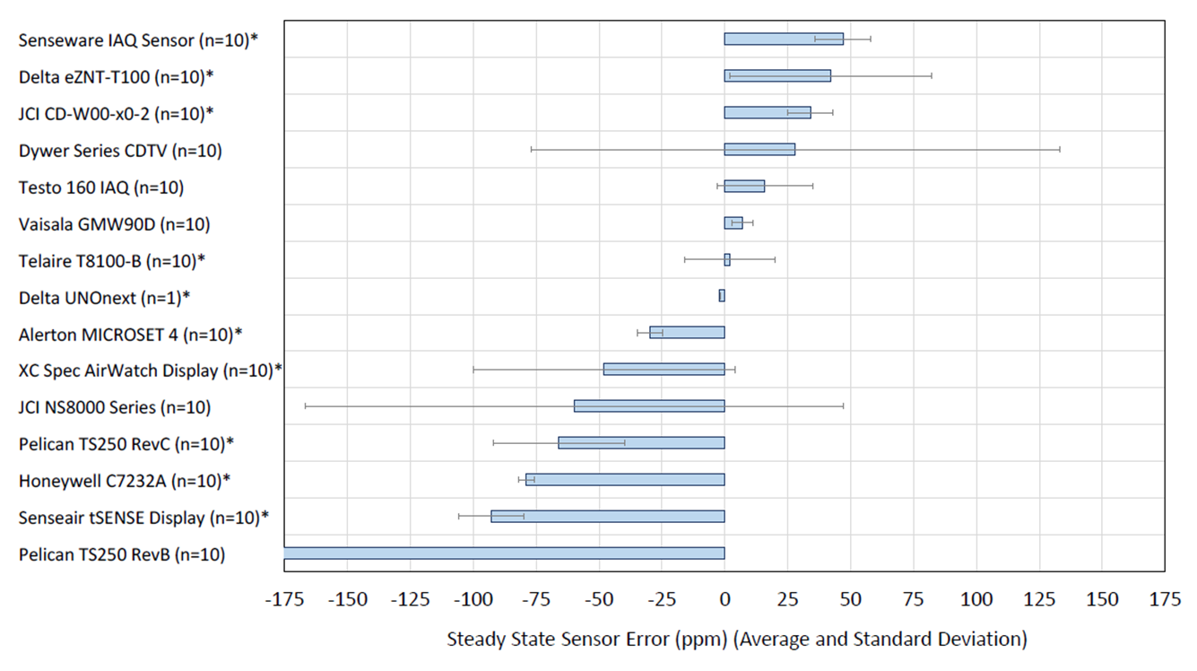
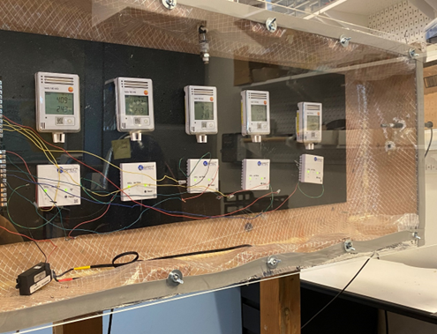
Air Technology Evaluation – CO₂ Sensors
CO₂ Sensor Performance Testing
ACCURACY
(https://energyproductevaluations.org/)

Slide 4
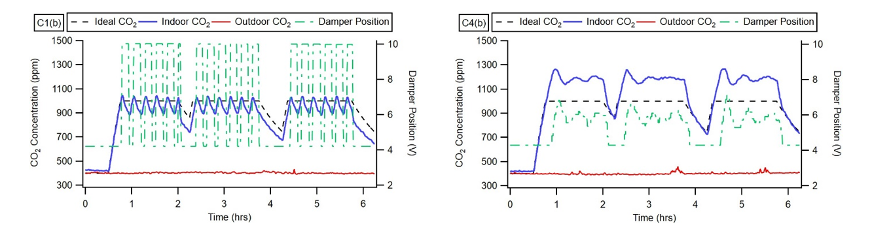
Air Technology Evaluation – Demand Control Ventilation (DCV)
Measured Behavior for Two Controllers
Damper Control
Actual Concentration

Slide 5
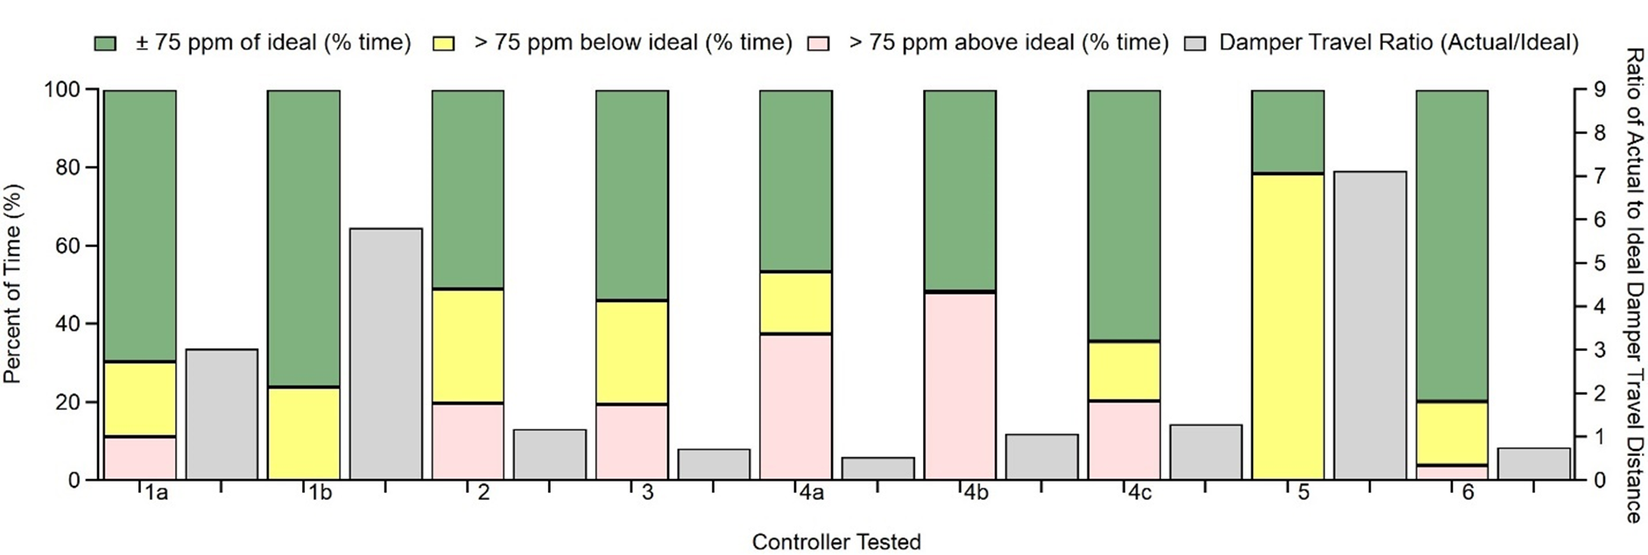
Air Technology Evaluation – Demand Control Ventilation (DCV)
How Well Do Different Controllers Actually Control CO₂?
(https://energyproductevaluations.org/)

Slide 6
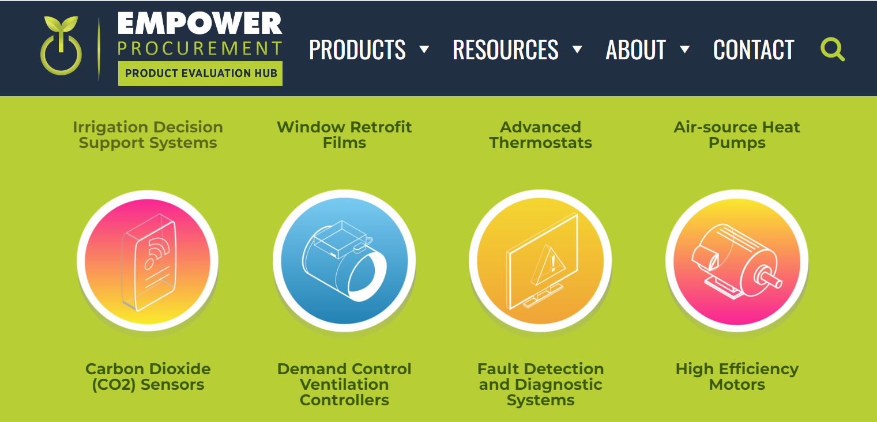
Technology Evaluation Hub
https://energyproductevaluations.org/

Slide 7
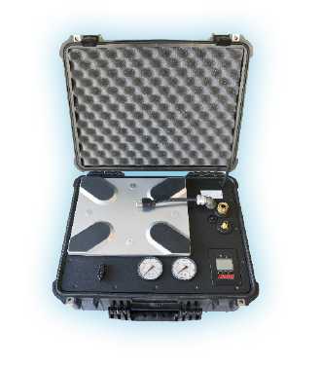
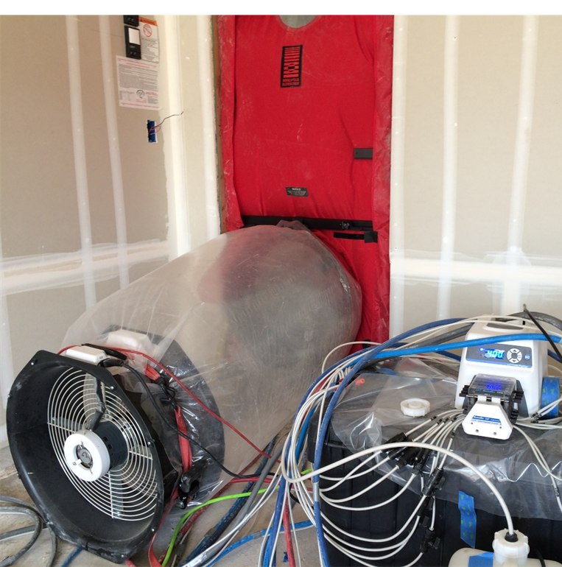
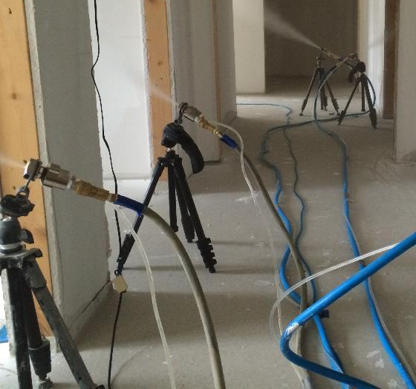
Licensed Uc davis Innovations
Tracer Gas System
New system that allows for accurate airflow measurement over a wide range of operating conditions
Envelope & Pipeline Sealing
Automatically seal building-envelope and gas distribution leaks with instant verification of results.

Slide 8
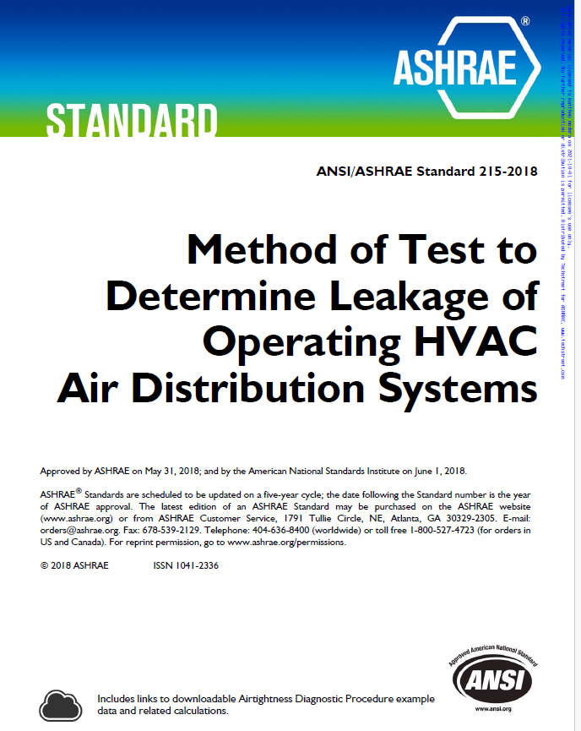
Measuring Duct Leakage: ASHRAE Standard 215
(Tracer Gas Version)
How Many People in the Audience have Measured Duct Leakage?
How Many have Heard of ASHRAE Standard 215?
ASHRAE Standard 215 = Methodology for Measuring Duct Leakage Flow (Absolute and % of Duct Flow)
  Similar to Test and Balance Methodologies
  Unique Characteristics:
    Provides methodology for calculating accuracy of measured leakage
    Includes method for using a tracer gas to measure incoming flow

Slide 9
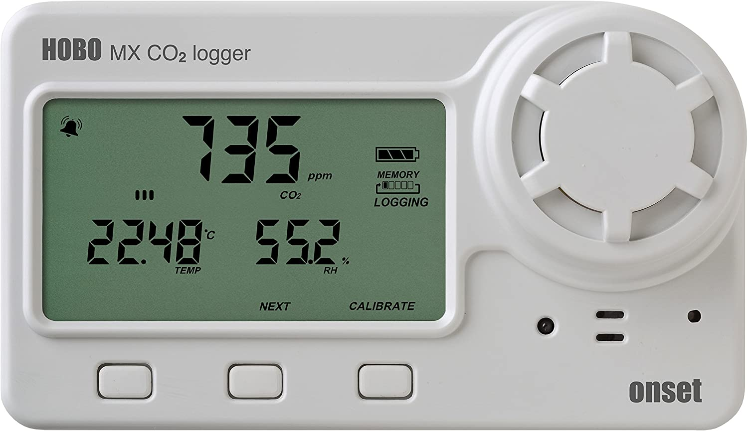
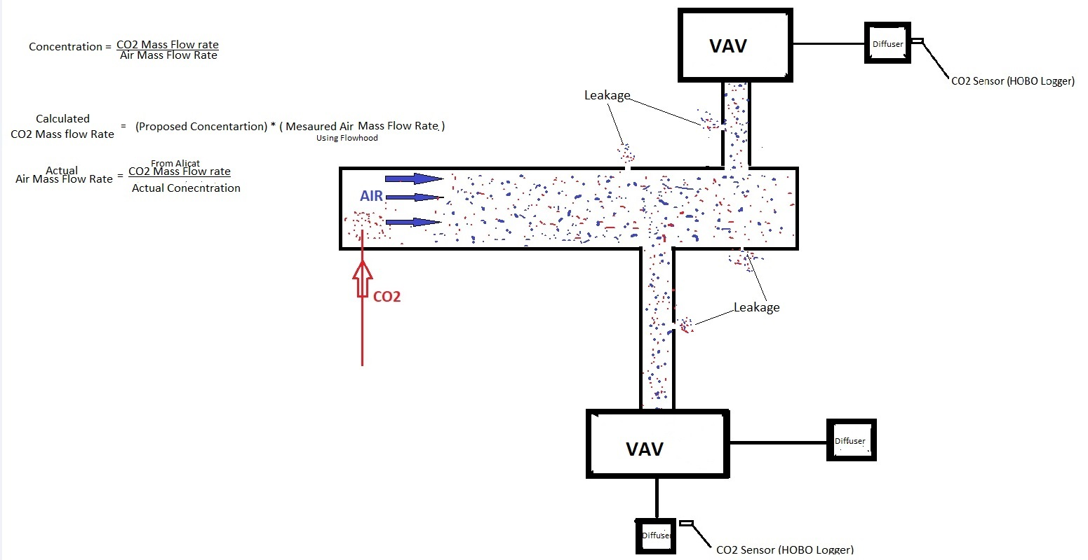
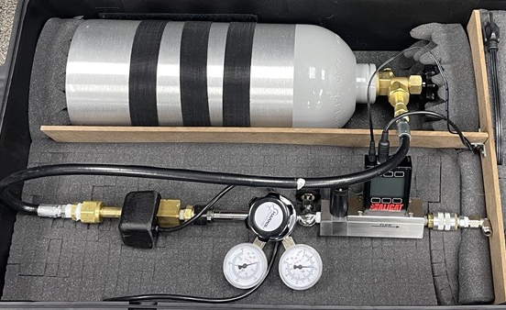
Measuring Incoming Flow with CO₂
CO₂ from cylinder enters heater, then pressure regulator
Warm low-pressure CO₂ enters mass flow controller [MEASURES CO₂ SCFM]
CO₂ injected and mixed in duct section
CO₂ concentration is measured at THREE diffusers
Leakage
CO₂ Concentration
Leakage
CO₂ Concentration
CO₂ Concentration

Slide 10

Measuring Incoming Flow with CO₂
    Incoming Air Flow [scfm] = $\frac{\text{CO}\text{2} \text{Flow}\text{ [}\text{scfm}\text{]}}{\text{CO}\text{2} \text{concentration} \text{CHANGE}\text{ [−]}}$

Slide 11
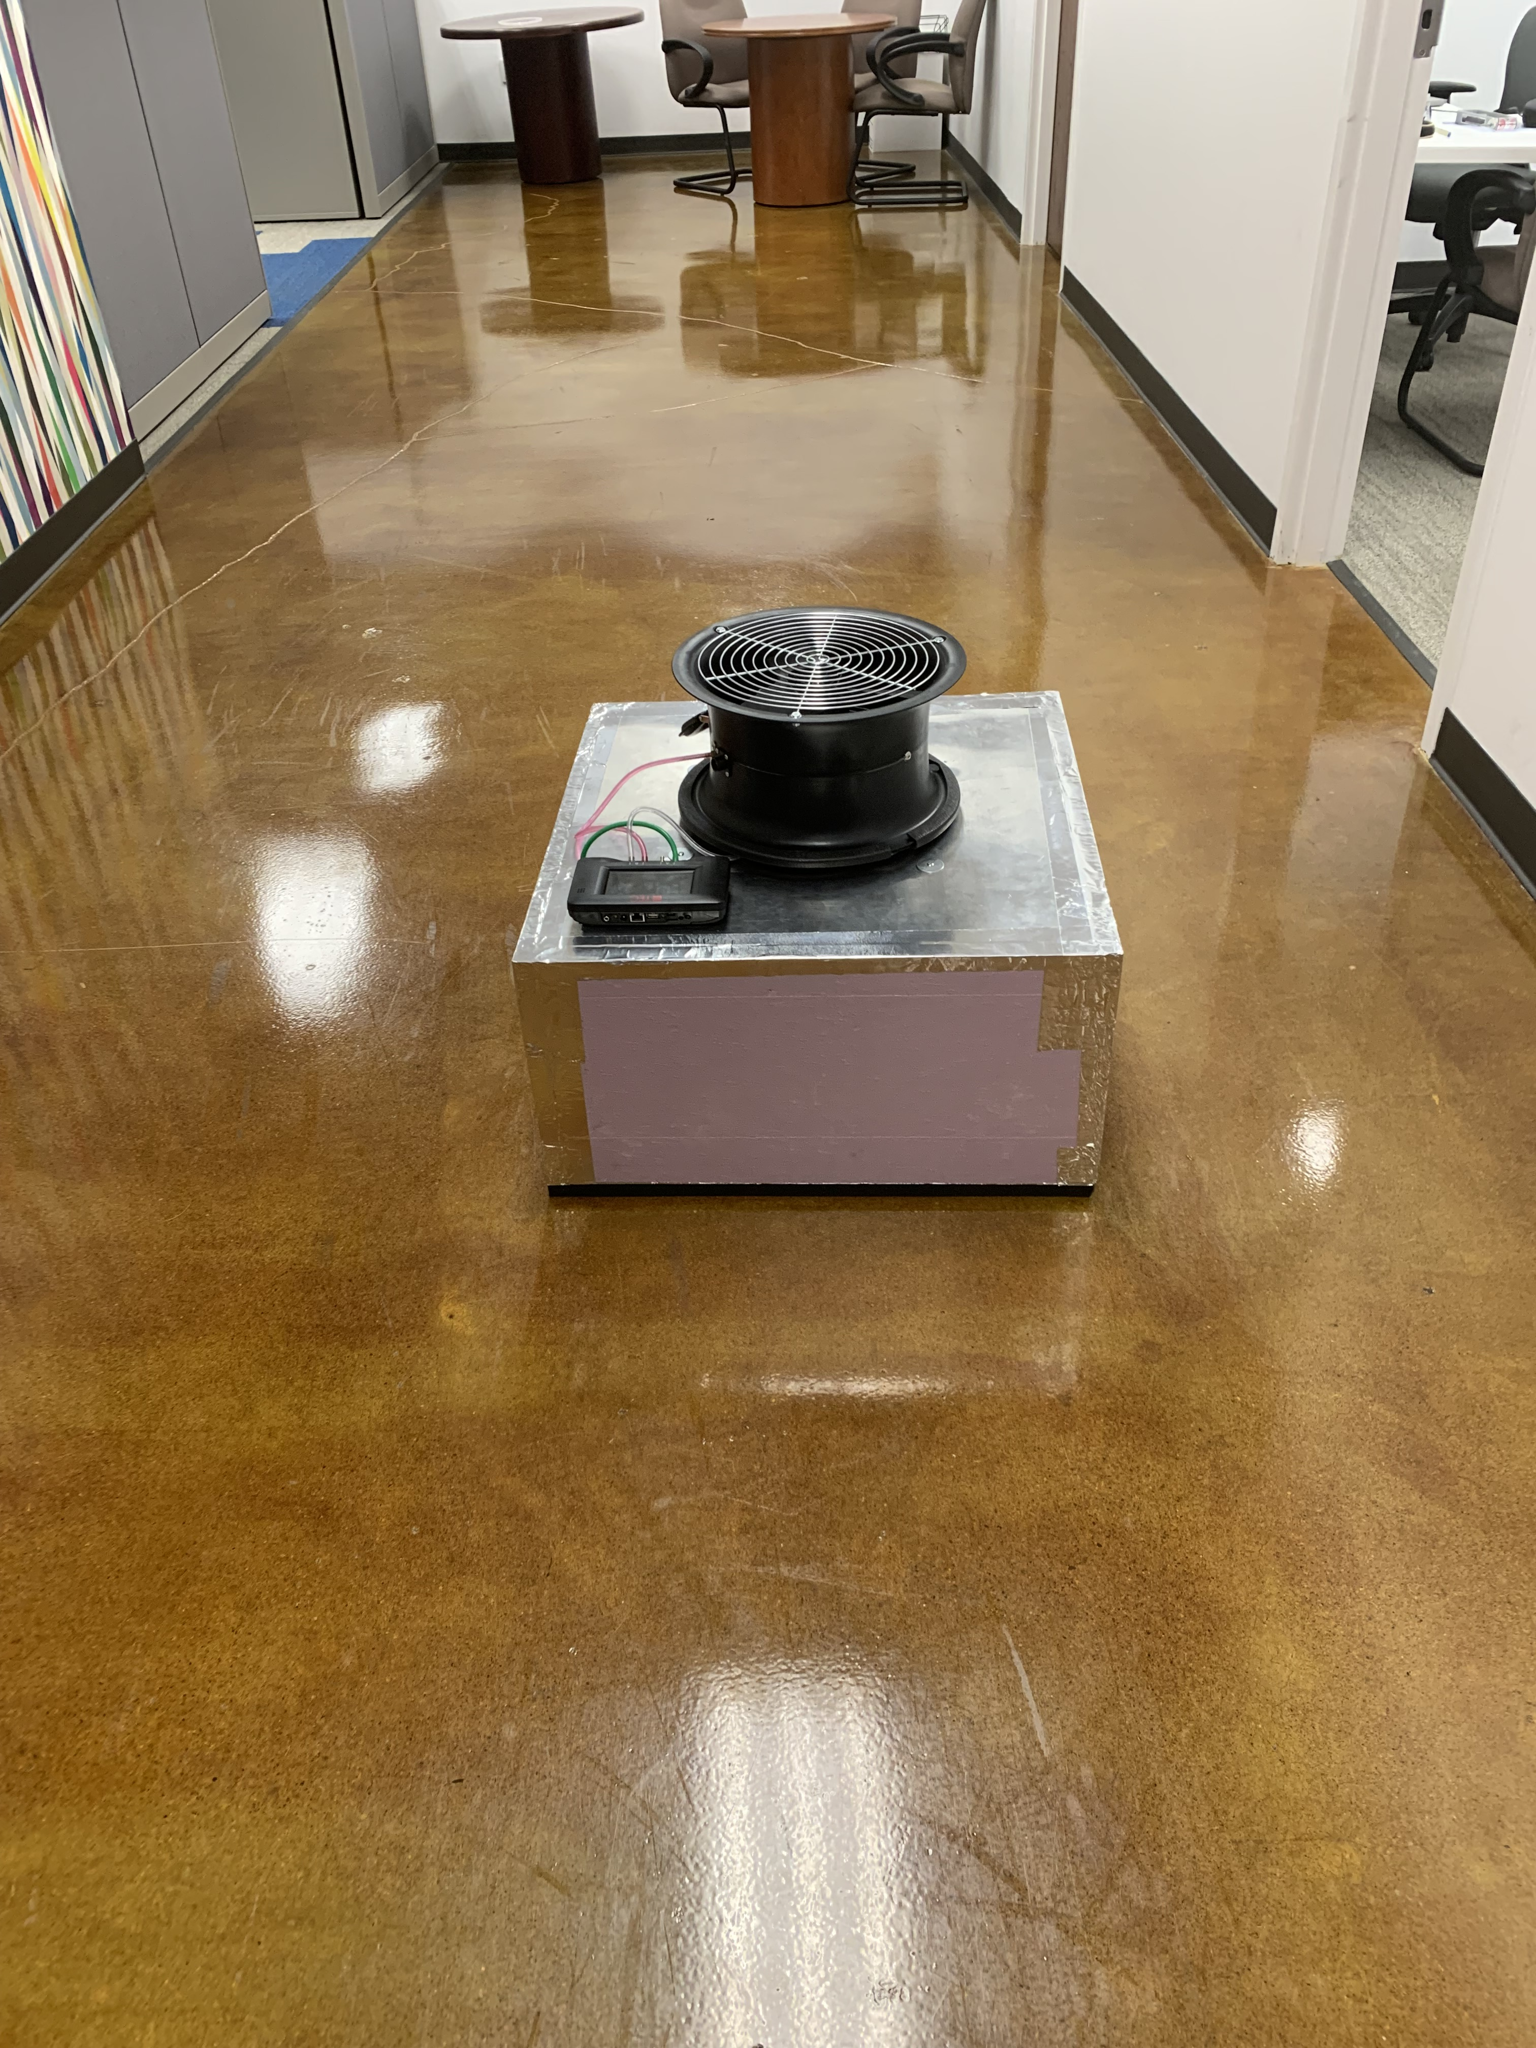
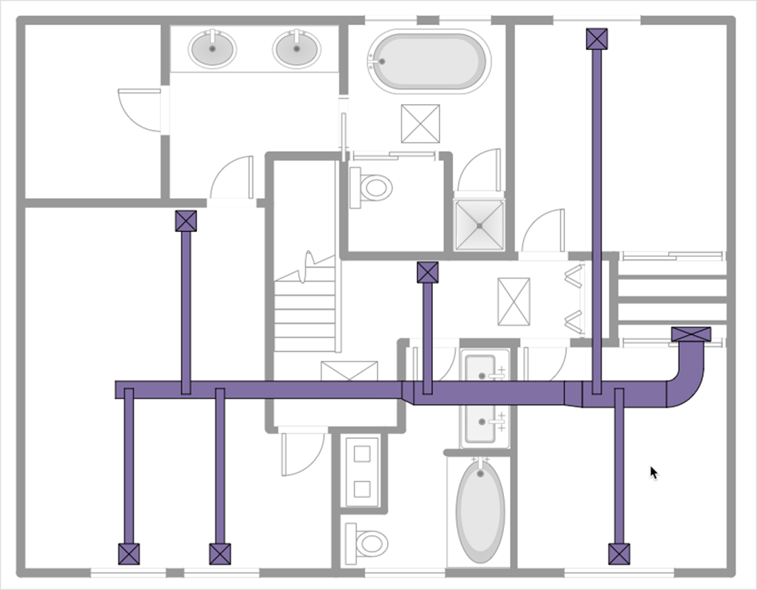
Measuring Diffuser Flows
Fan-Powered Flow Hood

Slide 12
Quantifying Measurement Uncertainty
– ASHRAE Standard 215
Incoming Flow Uncertainty Analysis
Alicat (tracer gas flow) | 2.0%
Tracer gas conc differential (sensors) | 2.0%
Mixing errors (CO₂ difference variations) | 2.3% | application specific
Uncertainty in incoming flow | 3.7%
EXAMPLE from UC Davis Building Test
CO₂ Concentration [ppm]
middle | SW | NE | NW | Avg
3300 | 3340 | 3250 | 3560 | 3363
400 | 400 | 400 | 400 | 400
2900 | 2940 | 2850 | 3160 | 2962.5
 |  |  | std dev | 137
 |  |  | std err in mean | 68
 |  |  | std err in mean | 2.3%
Diffuser Flow Uncertainty Analysis
Powered Hood Flow (individual grille) | 2%
Altitude and Temp Correction | 2%
Number of diffusers | 4
Uncertainty total Diffuser flow | 1.4%
Calculated leakage flow | 20%
Total uncertainty in leakage flow | 3.9% | absolute uncertainty
 | 20% | relative uncertainty

Slide 13
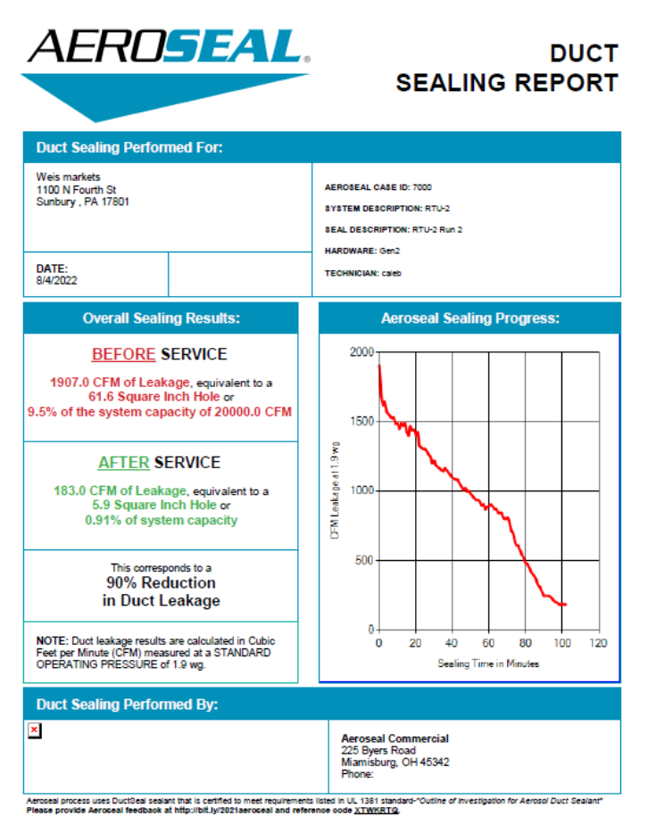
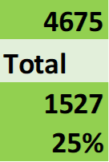
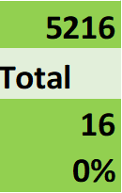
Tracer-System Case Study –
Sealing Verification in a Grocery Store
Flow [cfm]
Leakage Flow [cfm]
Leakage %
Flow [cfm]
Leakage Flow [cfm]
Leakage %

Slide 14
ASHRAE Standard 215 – Sample Results
Location (State, City) | Duct Flow | Leakage % | Building Type | VAV vs CAV | Diffuser Type | % Upstream
PA, Sunbury | 4622 | 25% | Grocery Store | CAV | Linear | N/A
OH, Dayton | 2394 | 22% | Office | CAV | 2'-2' | N/A
SC, Greensville | 2433 | 9% | Dining Hall | CAV | 2'-2' | N/A
KY, Madisonville | 3062 | 1% | Jail | CAV | 2'-2' | N/A
NC, Raleigh | 1778 | 7% | Classrooms | VAV | 2'-2' | 60%
FL, Miami #1 | 248 | 1% | Hospital | VAV | 2'-2' | 80%
FL, Miami #2 | 3796 | 13% | Hospital | VAV | 2'-2' | 60%
CO, Telluride | 608 | 20% | School | VAV | 2'-2' | 60%
AVERAGE |  | 12%
Standard Deviation |  | 9%

Slide 15
measured exhaust system leakage (U.S.)
Building | Fan Flow [cfm] | Leakage [%] | Notes
Condominium (40-Story) | 950 | 74% | Building-Cavity Bathroom Exhaust
NYS University Dorm (10-story) | 2,300 | 70% | Bath/Shower Exhaust
NYS University Dorm (7-story) | 2,050 | 54% | Bath/Shower Exhaust
Navy BEQ (10-story dorm) | 6,300 | 18% | Ducted Supply w/heat wheel
Navy BEQ (10-story dorm) | 6,470 | 54% | Building-Cavity Exhaust w/heat wheel
Barracks (8 3-story buildings) | 20,000 | 20% | Bath/Shower Exhaust
Office Toilet Exhaust (3-story) | 8,700 | 9% | No pre-qualification of leakage
Hospital Exhaust (9-story) | 8,200 | 19% | Sterilization room riser
Seven NYC Apartment Exhausts | 2,450 | 36% | Kitchen/Bath Exhausts
AVERAGE |  | 39%
Notes:
So how does duct leakage affect the customers’ comfort, their wallet, their home, and their equipment?
Obviously, the customer is paying for heating or cooling that is being wasted…air that never contributes to improving their comfort because the holes and gaps in ductwork let it escape. Imagine the financial savings if there was a way to prevent that air from escaping - in fact, the Electric Power Research Institute says that energy savings from duct improvement measures can save the average customer up to $300 a year.
Consider how gaps in ductwork allow unconditioned air to be drawn in during fan operation - that air, in addition to being unconditioned, is also filled with airborne pollutants that then make their way into your living areas. I don’t have to remind you of the comfort, health and equipment ramifications of poor indoor air quality.
What other issues do leaks in ductwork cause? They result in some rooms being comfortable, and other being uncomfortable because conditioned air leaks out of the ducts before reaching some of the rooms. And duct leaks may take an unnecessary toll on equipment by causing it to cycle more frequently.
All this aside….what is the main problem with duct leak? It means our customers are not as comfortable as they could be, and if they aren’t comfortable, then we - as a manufacturer and as dealers - have a problem.

Slide 16
Comparison of Return Ductwork and Open Plenums
How often do you see Ceiling-Plenum Returns rather than Ducted Returns?
Why do you think that is?
  Cost
  Fan Power
  Flexibility (ease of rearranging return grille locations)
What are the Drawbacks of Ceiling Plenum Returns?
  Difficult to Clean (IAQ)
  Leakage from Outdoors (due to negative pressure in plenum)
  Uniformity and Controllability of Return Flows?
  Limited Room Pressure Control capability?
UC Davis and University of Toronto plan to Research these Issues

Slide 17
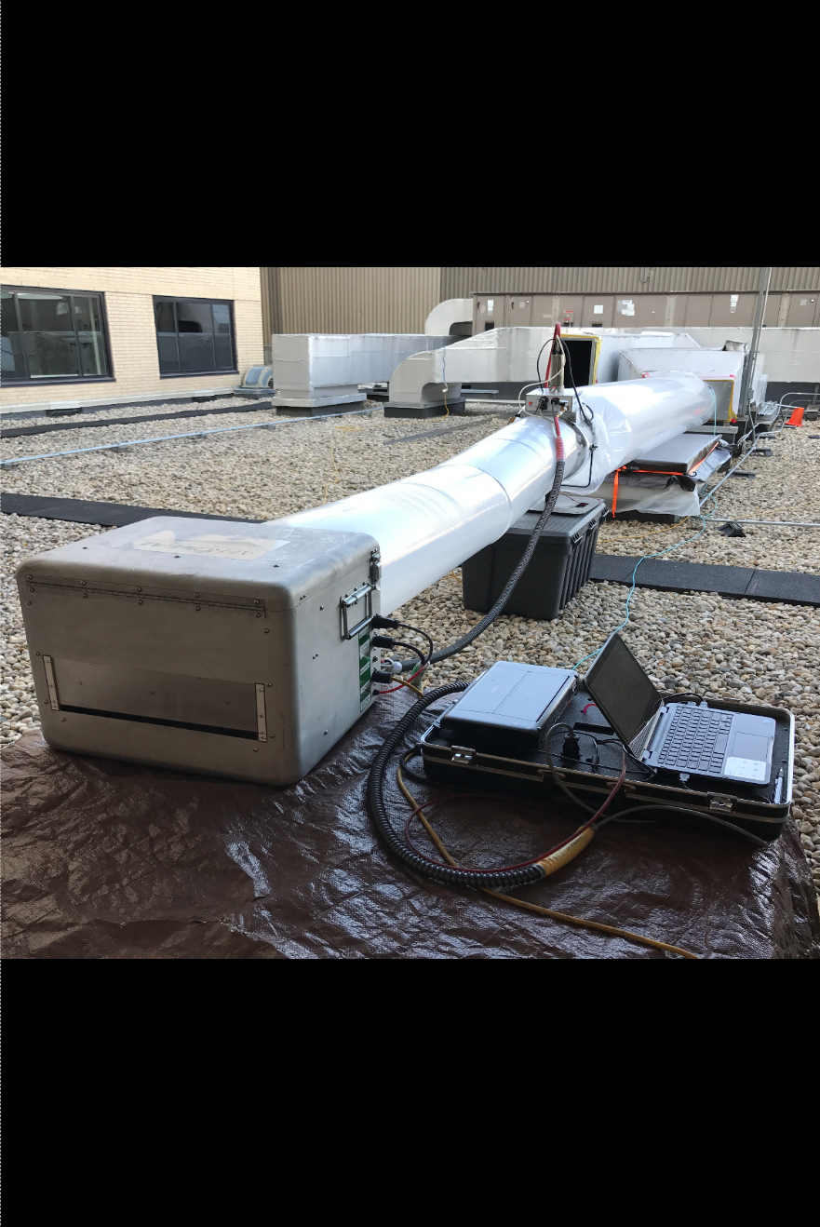
Aerosol Sealing Process
Joe St. Pierre midwest business development manager Aeroseal, llc

Slide 18
Duct leakage and Airside
Performance in
Healthcare

Slide 19
Air leakage - leading source
of energy waste in Healthcare
buildings.
Commercial buildings account for 35% of electricity consumption in the US.
Fans used in HVAC systems consume more than 40% of the electricity in a building.
A leaking VAV system uses 20 - 35% more fan energy than a tight system

Slide 20
Creating a better
environment for
your patients and staff
Reduce particulate and pathogen spread
Fix air flow and ventilation issues
Improve indoor air quality
Increase humidity and temperature control
Reduce noise
Comply with regulations

Slide 21
How can we effectively seal
commercial duct within an
existing building?

Slide 22
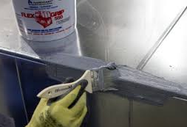
Traditional methods of duct
sealing
Required to paint mastic on exposed seams
Duct may not be 100% accessible
  Insulated (wrapped)
  Between walls / floors / Shafts, etc
Many cases post verification is required!

Slide 23
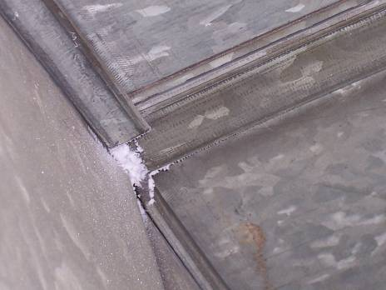
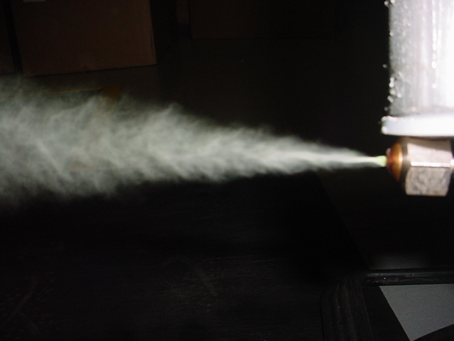
One existing-building option - remote sealing of ducts with aerosolized sealant
Notes:
So how does duct leakage affect the customers’ comfort, their wallet, their home, and their equipment?
Obviously, the customer is paying for heating or cooling that is being wasted…air that never contributes to improving their comfort because the holes and gaps in ductwork let it escape. Imagine the financial savings if there was a way to prevent that air from escaping - in fact, the Electric Power Research Institute says that energy savings from duct improvement measures can save the average customer up to $300 a year.
Consider how gaps in ductwork allow unconditioned air to be drawn in during fan operation - that air, in addition to being unconditioned, is also filled with airborne pollutants that then make their way into your living areas. I don’t have to remind you of the comfort, health and equipment ramifications of poor indoor air quality.
What other issues do leaks in ductwork cause? They result in some rooms being comfortable, and other being uncomfortable because conditioned air leaks out of the ducts before reaching some of the rooms. And duct leaks may take an unnecessary toll on equipment by causing it to cycle more frequently.
All this aside….what is the main problem with duct leak? It means our customers are not as comfortable as they could be, and if they aren’t comfortable, then we - as a manufacturer and as dealers - have a problem.

Slide 24

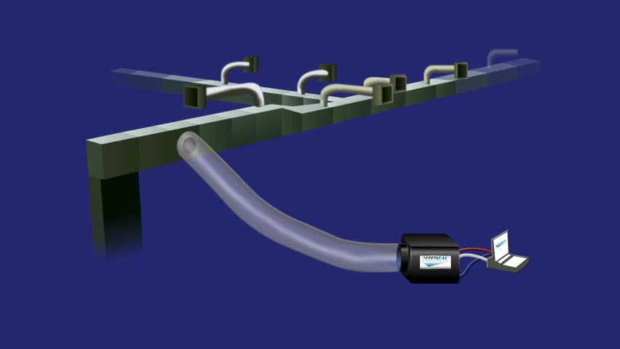
Aerosol Sealing Process
CUT ACCESS HOLES
ISOLATE FAN(S)
BLOCK DIFFUSERS, VAV’S, COILS, ETC.
CONNECT INJECTION EQUIPMENT
PRE-SEAL TEST (BASELINE)
INJECT ATOMIZED SEALANT
POST-SEAL: MEASURE FINAL LEAKAGE
PRESENT FINAL CERTIFICATE(S)

Slide 25
DUCT SEALANT
VINYL POLYMER
REMAINS FLEXABLE
NO OFFGASSING
UL 1381
  MOLD GROWTH
  EROSION
  FLAME SPREAD
  DURABILITY

Slide 26
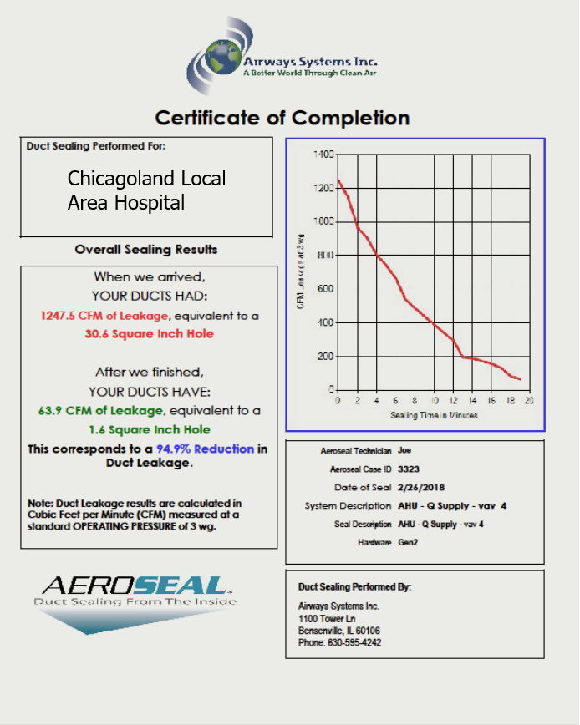
Certificate of Completion
When we arrived
YOUR DUCTS HAD:
1,247.5 CFM of Leakage equivalent
After we finished
YOUR DUCTS HAVE
63.9 CFM of Leakage equivalent
This corresponds to a 94.9%
Reduction in Duct Leakage

Slide 27
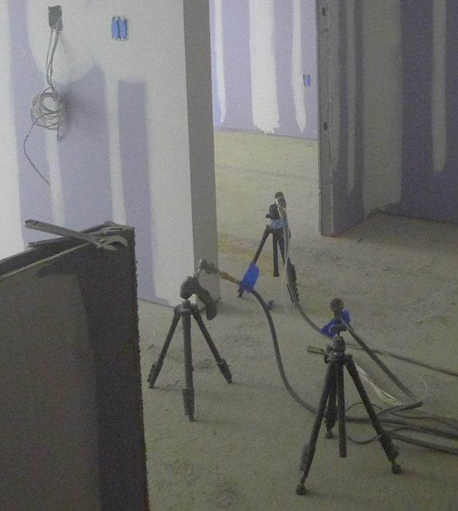
Aerosol Building Sealing Technology
Basic Concept
  Use blower door to pressurize Zone to be sealed
  Fog Zone with aerosolized sealant particles
  Utilize sealant material with no residual tack

Slide 28
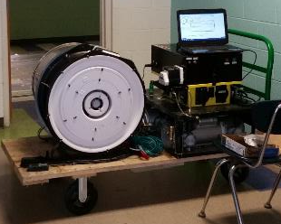
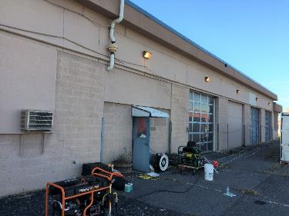
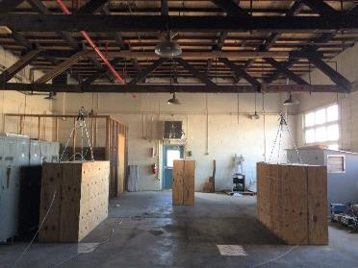
Aerosol Building Sealing Technology – DOD Buildings

Slide 29
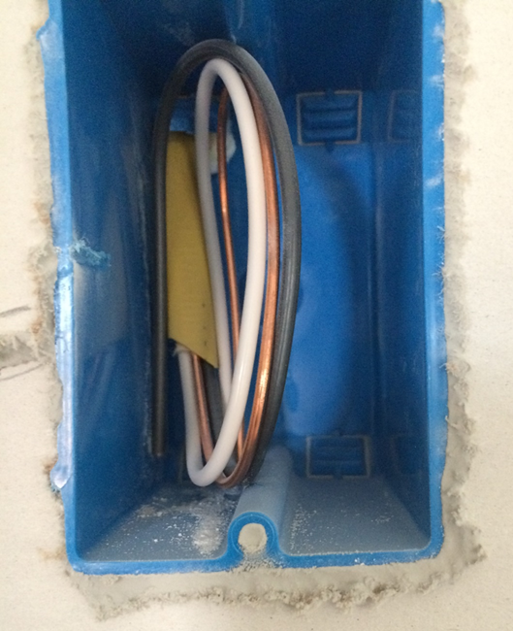
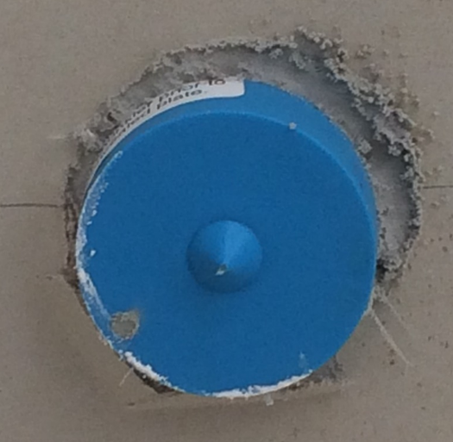
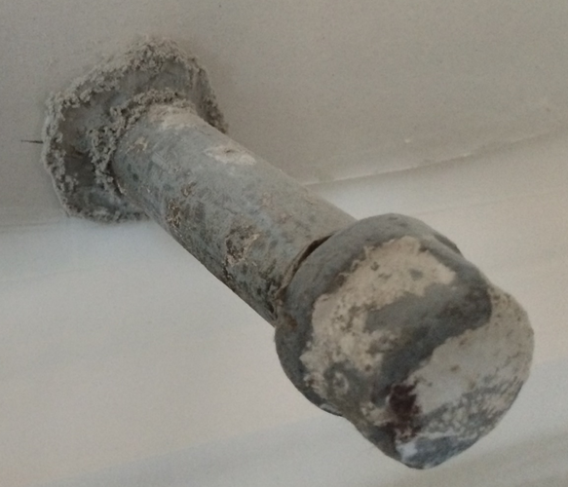
Post-Sheetrock Aerosol-Sealed Leaks

Slide 30
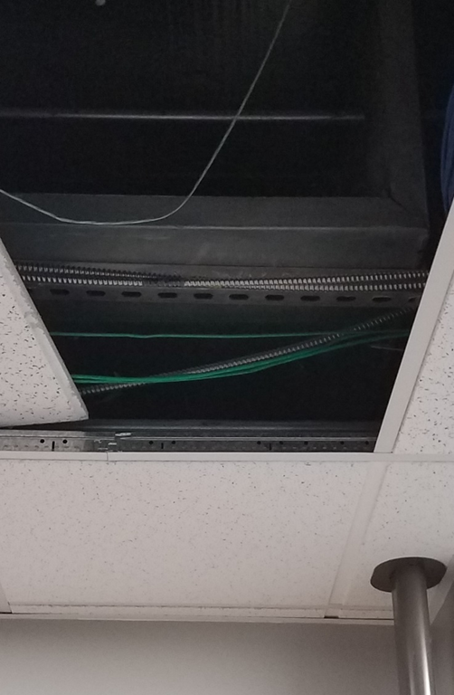
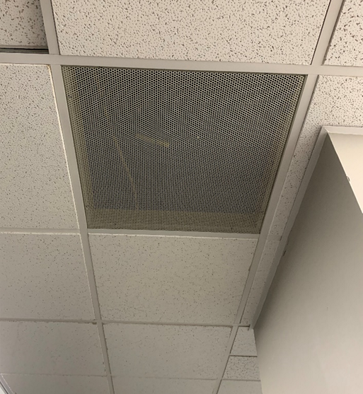
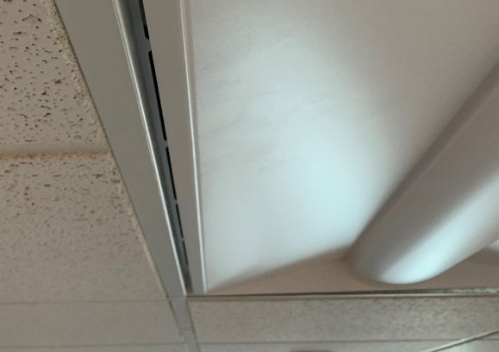
remote sealing of building zones with aerosolized sealant
New Application being explored – sealing leaks between ceiling plenum return and outdoors
  Pressurize room with a blower door
  Place injectors above the ceiling tiles
  Sealant controlled by air flow from room to ceiling plenum
Notes:
So how does duct leakage affect the customers’ comfort, their wallet, their home, and their equipment?
Obviously, the customer is paying for heating or cooling that is being wasted…air that never contributes to improving their comfort because the holes and gaps in ductwork let it escape. Imagine the financial savings if there was a way to prevent that air from escaping - in fact, the Electric Power Research Institute says that energy savings from duct improvement measures can save the average customer up to $300 a year.
Consider how gaps in ductwork allow unconditioned air to be drawn in during fan operation - that air, in addition to being unconditioned, is also filled with airborne pollutants that then make their way into your living areas. I don’t have to remind you of the comfort, health and equipment ramifications of poor indoor air quality.
What other issues do leaks in ductwork cause? They result in some rooms being comfortable, and other being uncomfortable because conditioned air leaks out of the ducts before reaching some of the rooms. And duct leaks may take an unnecessary toll on equipment by causing it to cycle more frequently.
All this aside….what is the main problem with duct leak? It means our customers are not as comfortable as they could be, and if they aren’t comfortable, then we - as a manufacturer and as dealers - have a problem.

Slide 31
Case studies

Slide 32
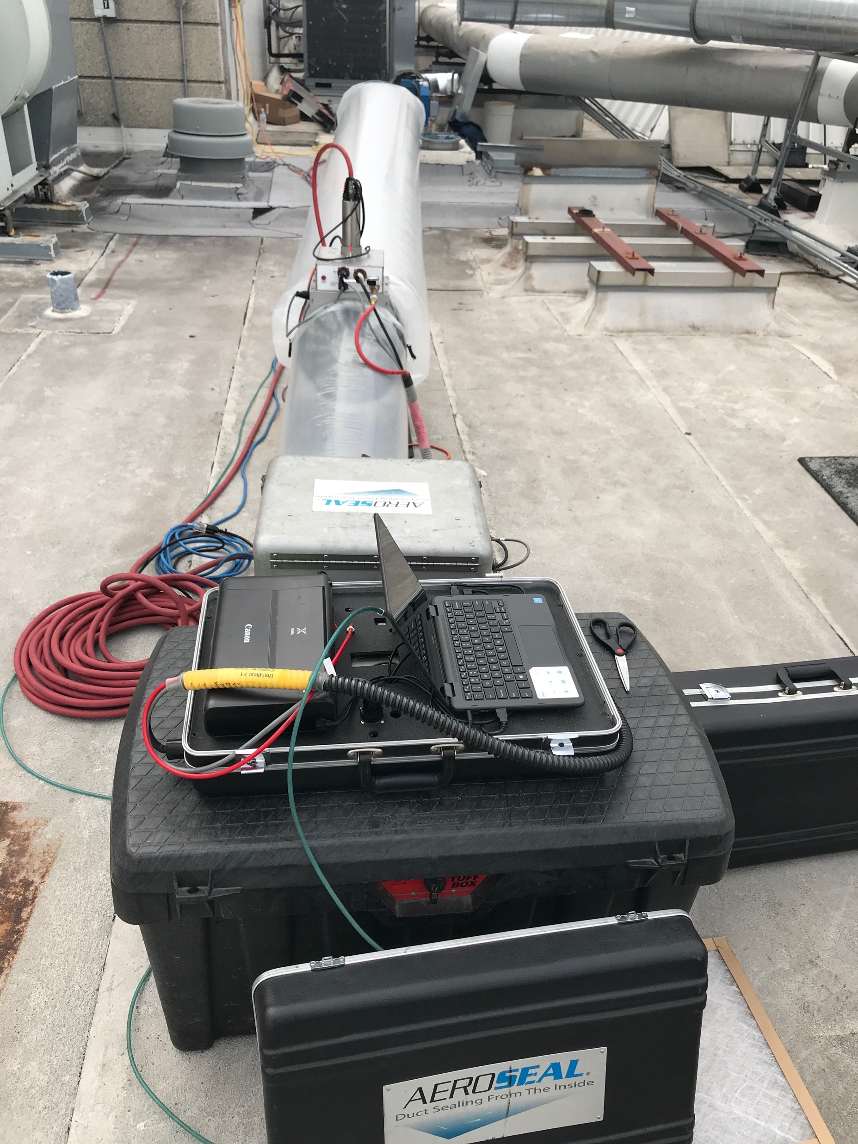
LOCAL AREA HOSPITAL
GOAL
MEET DESIGN FLOW AT GRILLES FOR A BRONCHOSCOPY LAB
  CLEANED/SEALED EXHAUST RISERS
  INITIAL LEAKAGE 514 CFM
  POST LEAKAGE 33 CFM
  LEAKAGE REDUCTION 94%
  COMPLETED IN 1DAY

Slide 33
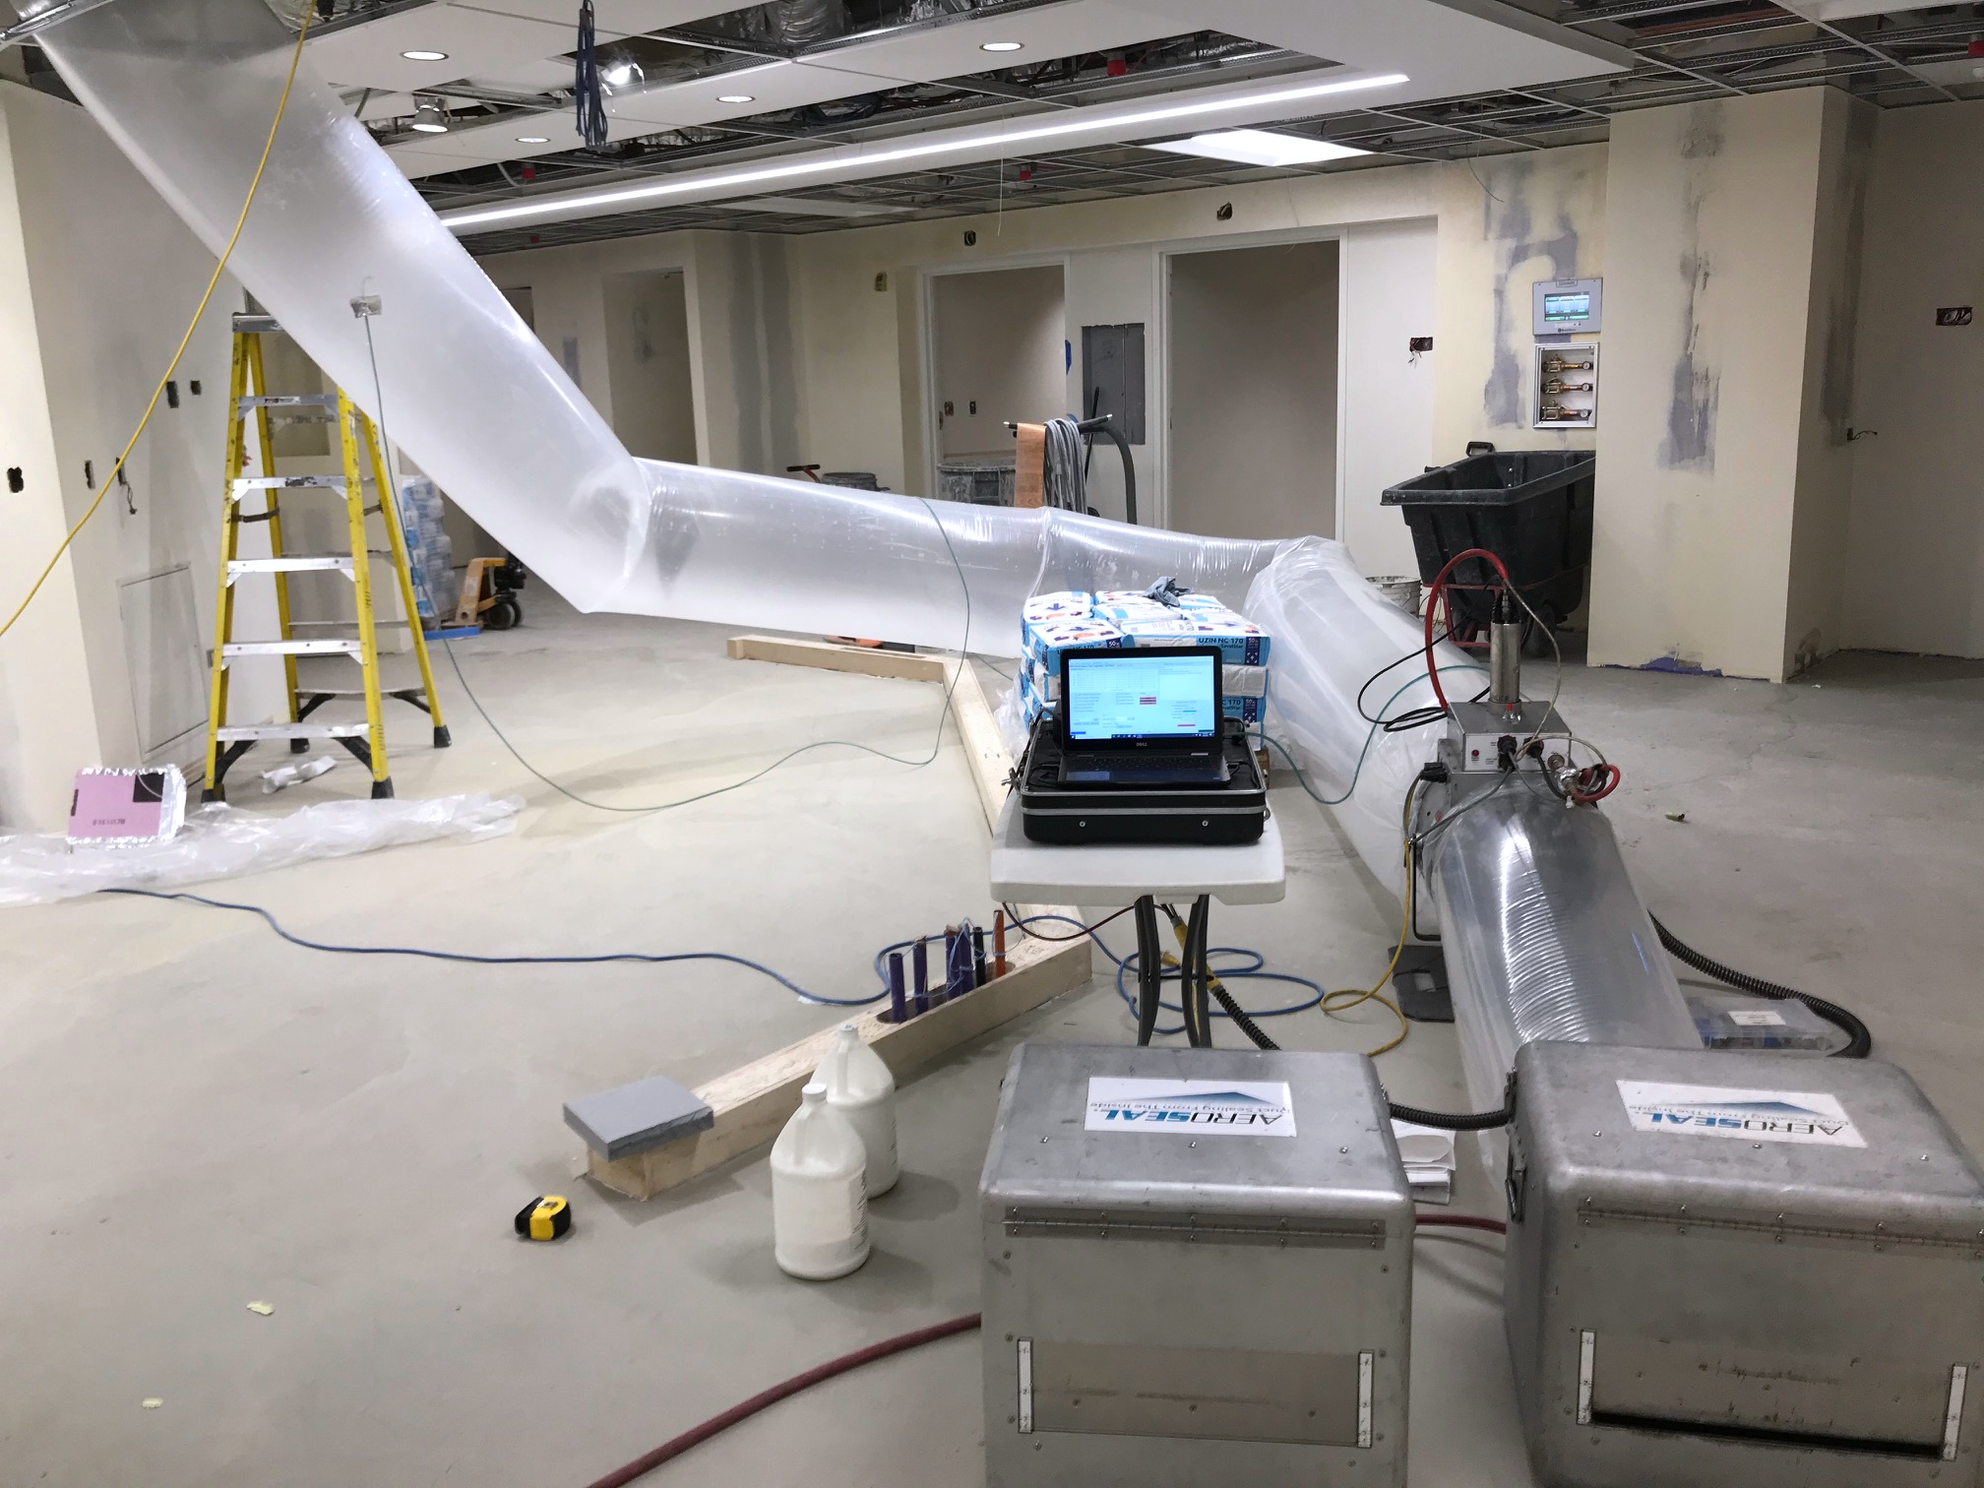
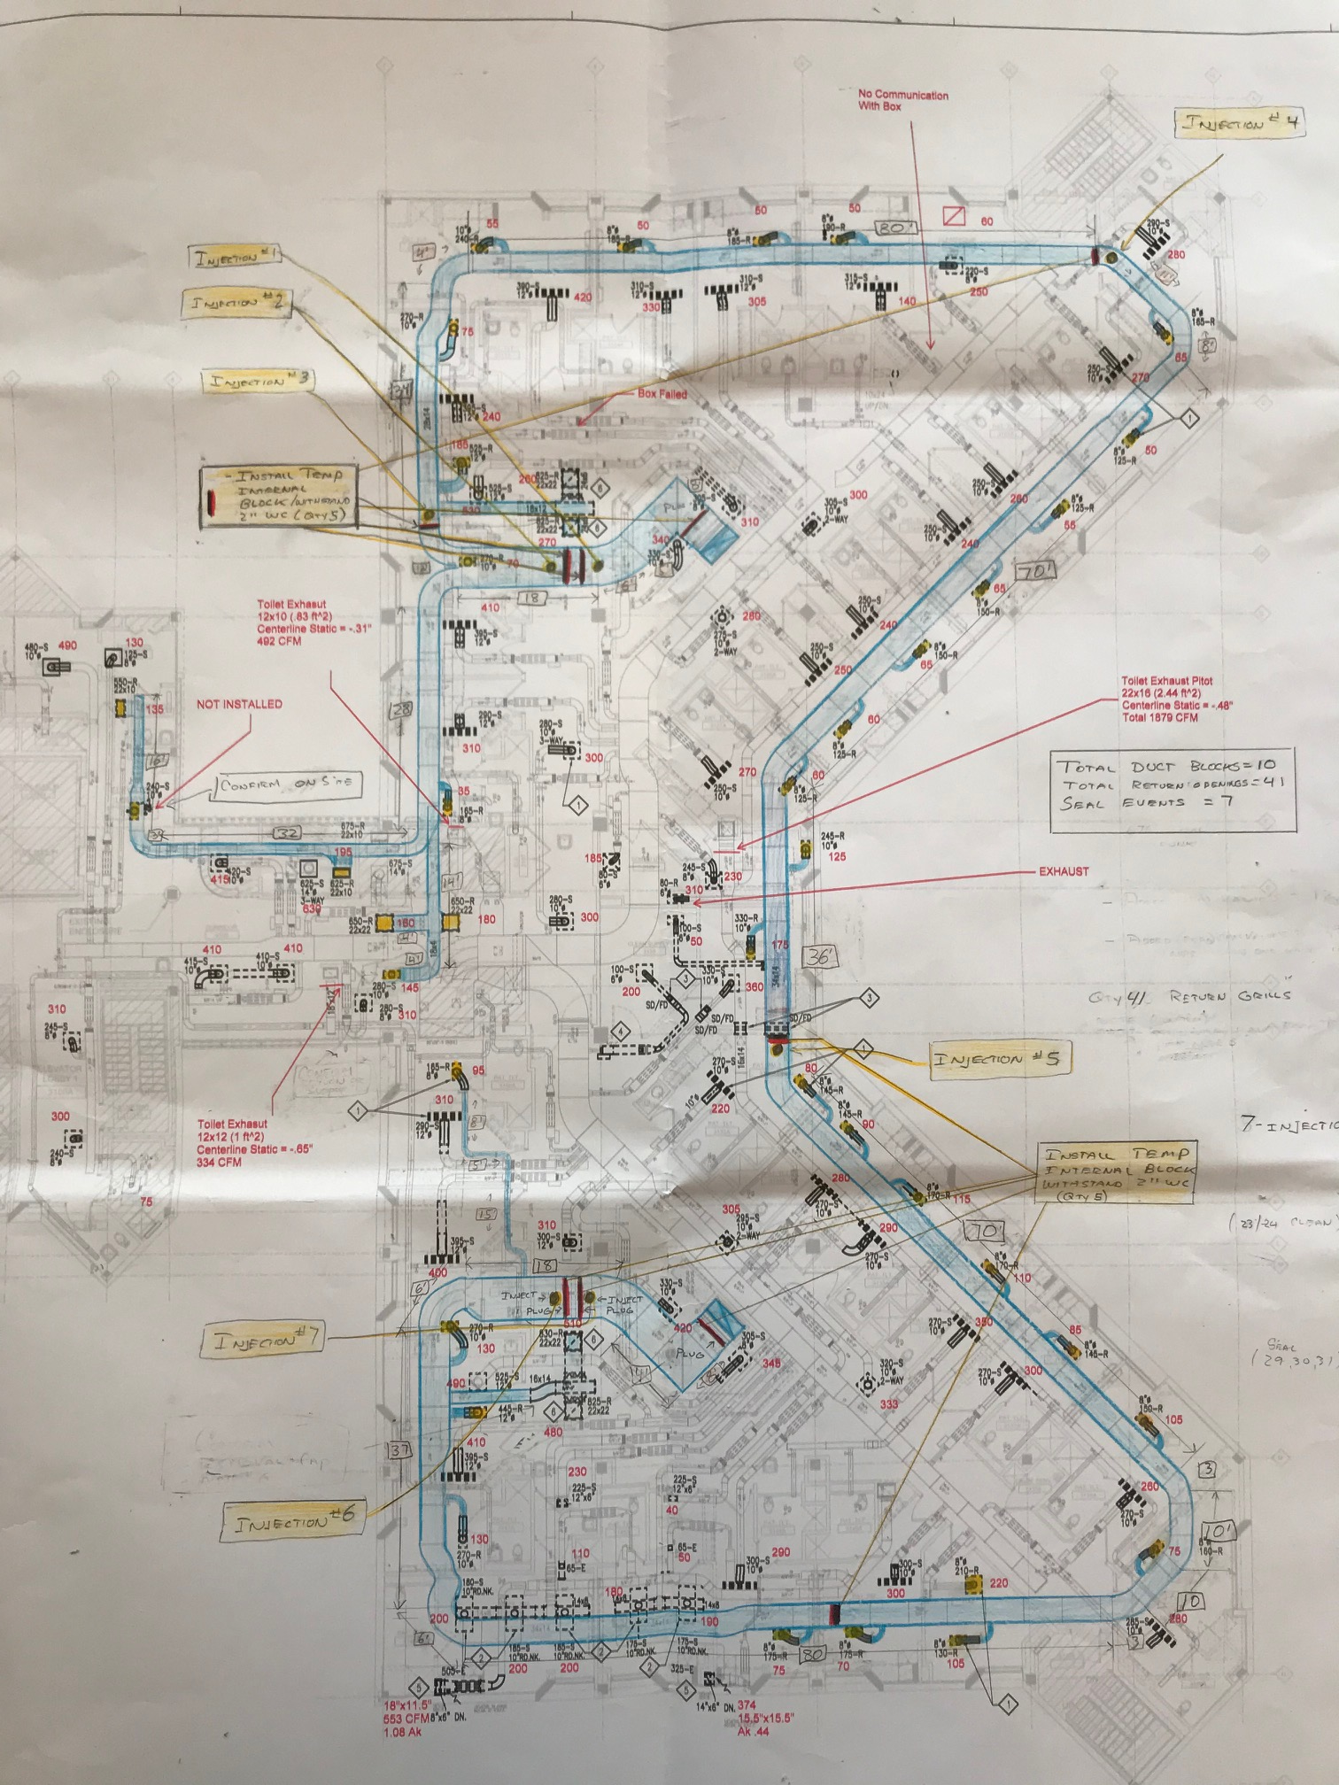
LOCAL AREA HOSPITAL
GOAL
IMPROVE AIR DISTRIBUTION IN A PATIENT WING
  CLEANED/SEALED OVER 500’ DUCT
  7 SEPARATE INJECTIONS
  INITIAL LEAKAGE 1,867 CFM
  POST LEAKAGE 230 CFM
  REDUCTION 97.6%
  MET DESIGN AT DIFFUSERS
  COMPLETED IN 2 DAYS

Slide 34
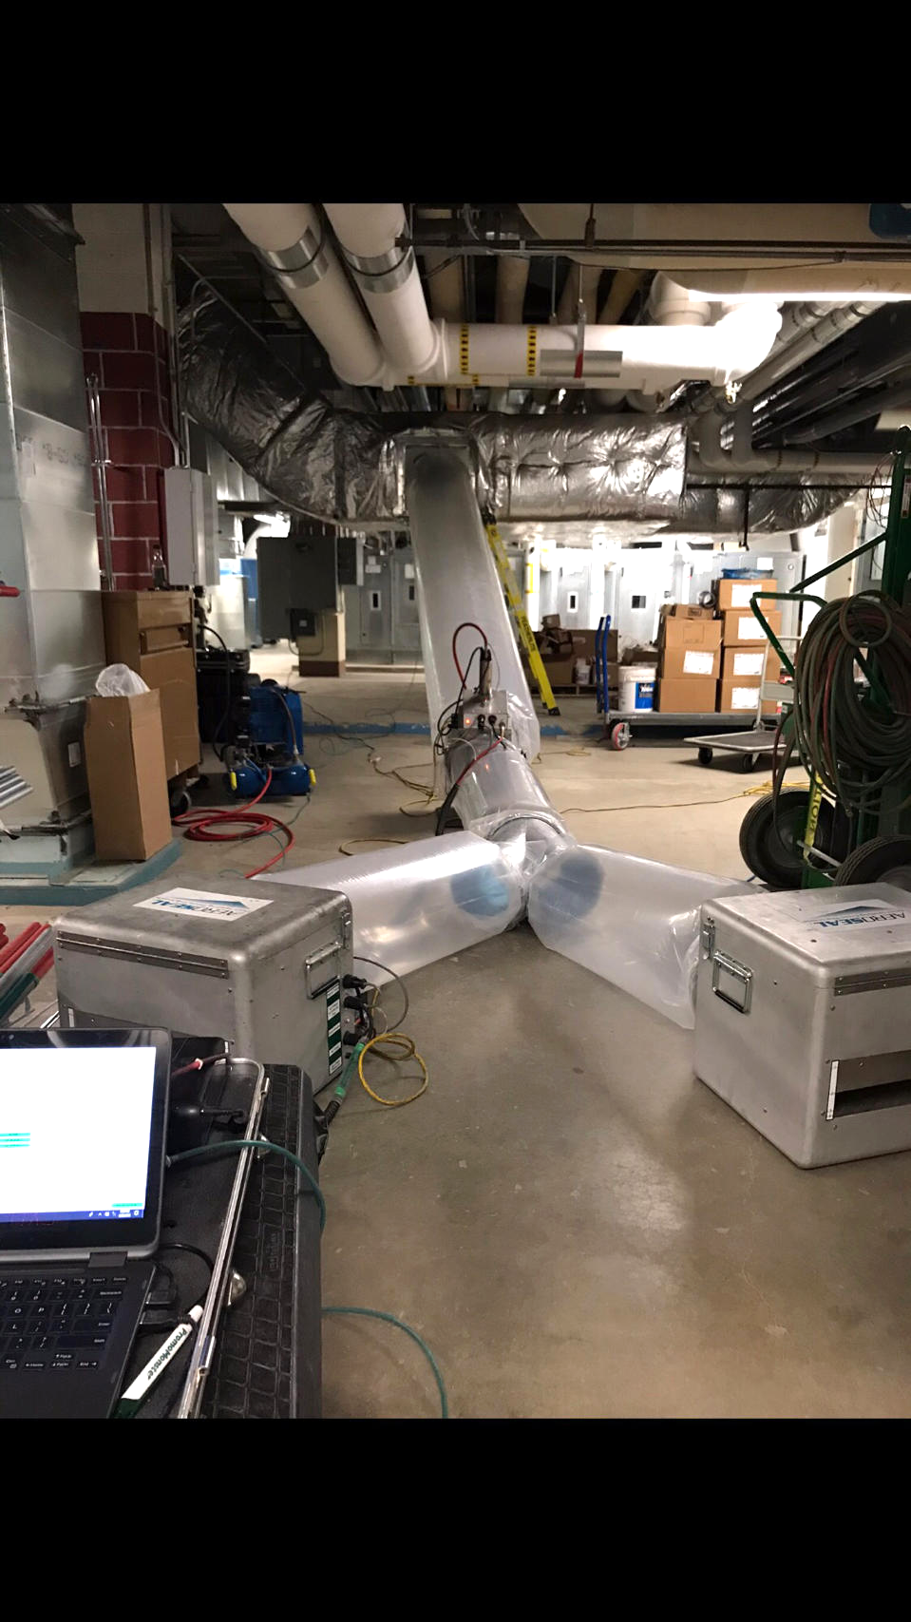
LOCAL AREA HOSPITAL
GOAL
IMPROVE AIR DISTRIBUTION OVER 7 AHU’S (TOTAL FAN DESIGN 152,700)
  INITIAL LEAKAGE 20,646 CFM
  POST LEAKAGE 845 CFM
  RECOVERED 19,801 CFM
  (49.50 COOLING TONS)
  REDUCTION 95.9%

Slide 35
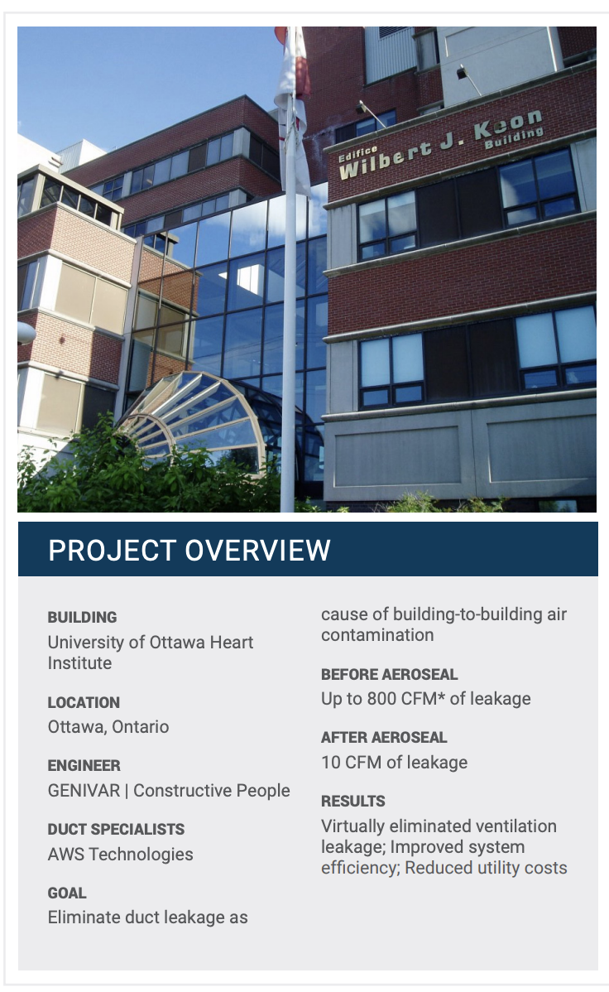

GOAL
Eliminate duct leakage as a cause of building-to-building air contamination
  Initial Leakage 800 CFM
  Post Leakage 10 CFM

Slide 36
Potential Open-Plenum LEAKAGE Solution
New Application by Aeroseal of UCD-developed Envelope Sealing Technology

Slide 37
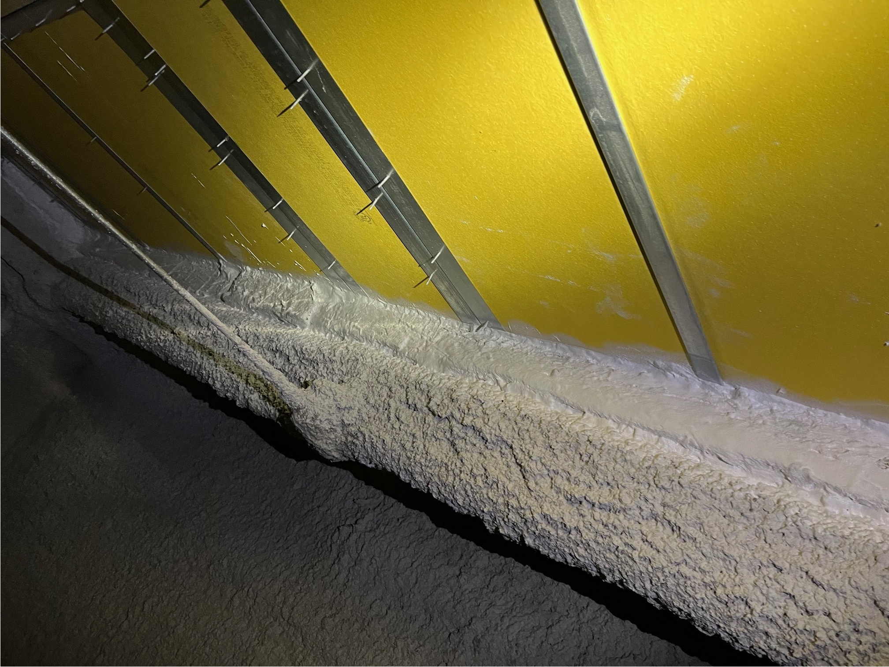
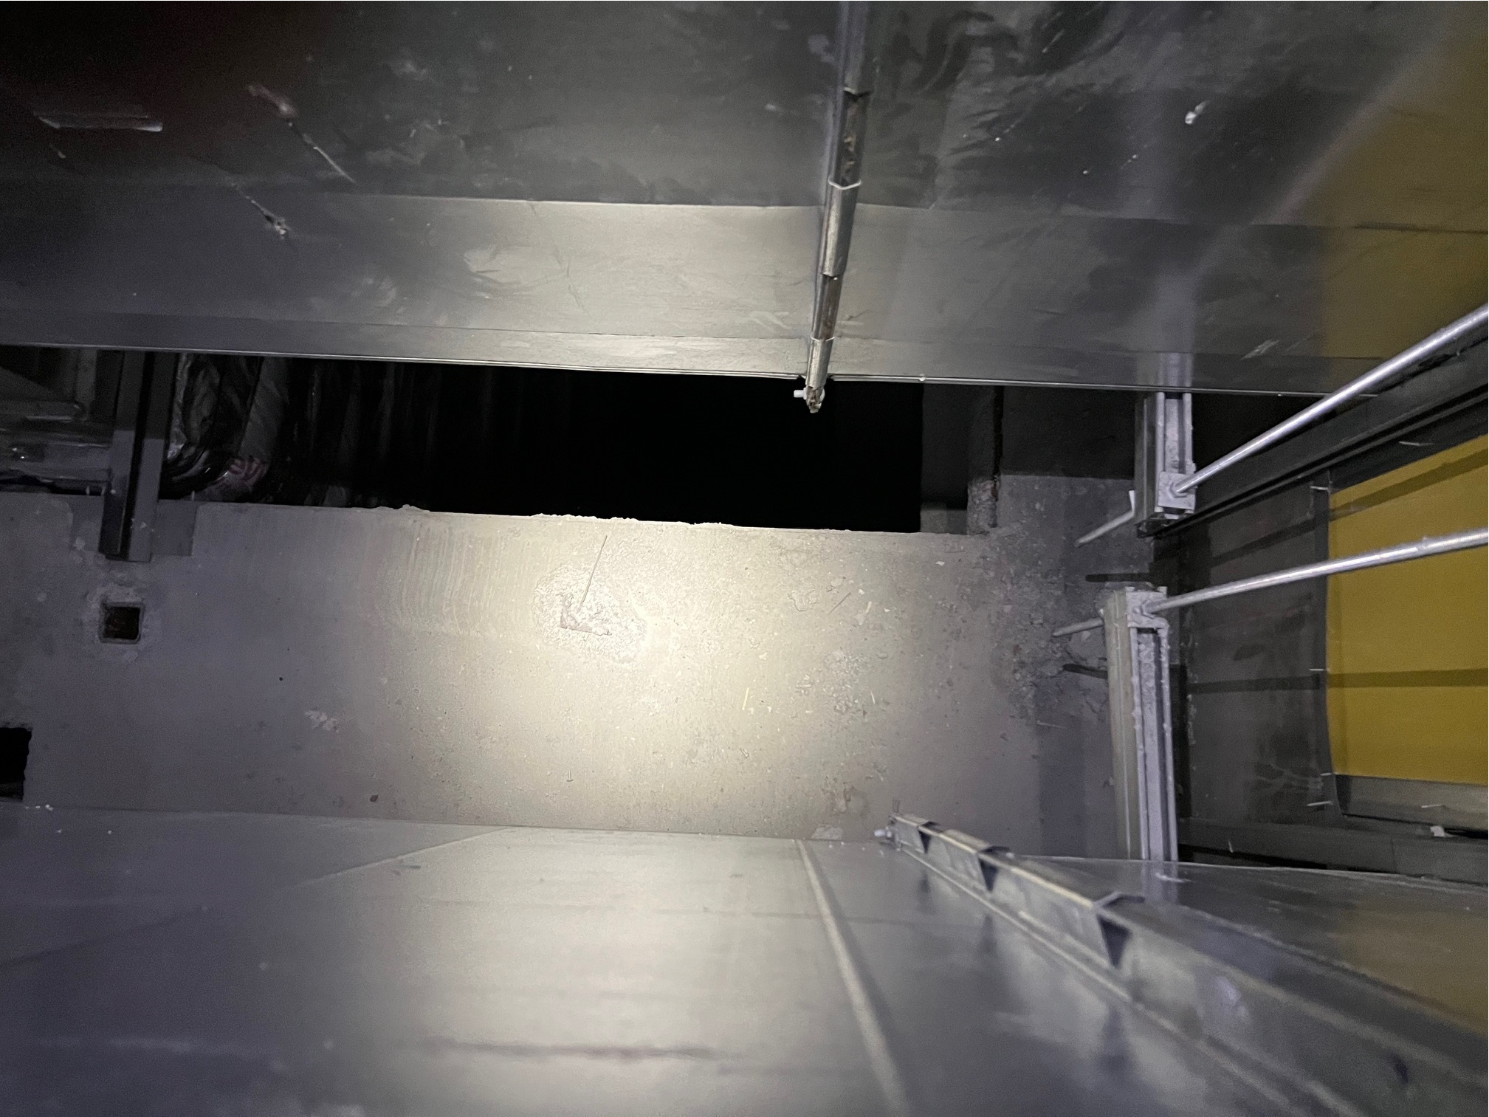
Unusual Aerosol Sealing Application –
Fire Exhaust Shaft in BioTech Building
Application
Fire/Smoke Exhaust Shaft
25’ by 25’ by 100’ Tall
Initial Problem
System not meeting floor exhaust spec (50% low)
Had spent months attempting to manually seal leaks in shaft

Slide 38
Unusual Aerosol Sealing Application –
Fire Exhaust Shaft
Sealing Process
Had to Inject below Ducts in Shaft
Combination of Duct and Envelope Sealing

Slide 39
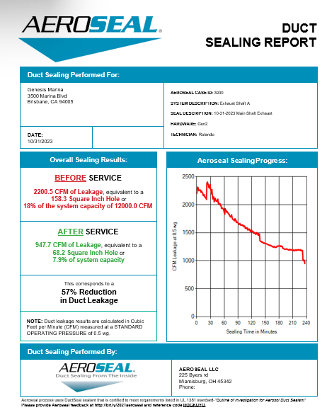
Unusual Aerosol Sealing Application –
Fire Exhaust Shaft
Sealing Results
 | Before | After
Pressure | 0.38” wg | 0.89” wg
Air Flow | 4,200 cfm | 9,080 cfm
Leakage | 66% | 25%

Slide 40
Sealing Technology FAQs
Does not coat the ducts
Vinyl polymer is safe
No lingering odors or off-gassing
Lasts 10+ years
Seals holes up to 1/2” across
Sealant remains rubbery
Need not clean before sealing, however it is better to clean very dirty exhausts
Cleaning after sealing generally does not hurt seals
Notes:
Now let’s talk about some of the outstanding questions I know you have about the Aeroseal process.
Aeroseal has the ability to seal gaps and holes up to 3/8 of an inch wide. And after these gaps or holes are sealed the vinyl polymer sealant remains rubbery so it won’t crack and break as a result of duct vibration.
There isn’t a reason to have ducts cleaned before the sealing process and the sealant will only collect on holes in the ductwork - it does not coat the ductwork in its entirety.
The vinyl polymer that makes up the sealing material is safe - test and approved by UL - and contains the same type of substance you find in chewing gum and in hair spray.
While there is a slight odor during the application, there is no residual odor once the process is finished.
The duct sealing is also guaranteed for 10 years.

Slide 41
Summary
Various Large Building Technologies are evaluated by third parties on the Empower Procurement Product Evaluation Hub
UC Davis has developed and licensed technologies that are pertinent to large-building HVAC performance
Tracer-Gas Flow Measurement can facilitate duct leakage measurement and ventilation flow measurement
Notes:
So how does duct leakage affect the customers’ comfort, their wallet, their home, and their equipment?
Obviously, the customer is paying for heating or cooling that is being wasted…air that never contributes to improving their comfort because the holes and gaps in ductwork let it escape. Imagine the financial savings if there was a way to prevent that air from escaping - in fact, the Electric Power Research Institute says that energy savings from duct improvement measures can save the average customer up to $300 a year.
Consider how gaps in ductwork allow unconditioned air to be drawn in during fan operation - that air, in addition to being unconditioned, is also filled with airborne pollutants that then make their way into your living areas. I don’t have to remind you of the comfort, health and equipment ramifications of poor indoor air quality.
What other issues do leaks in ductwork cause? They result in some rooms being comfortable, and other being uncomfortable because conditioned air leaks out of the ducts before reaching some of the rooms. And duct leaks may take an unnecessary toll on equipment by causing it to cycle more frequently.
All this aside….what is the main problem with duct leak? It means our customers are not as comfortable as they could be, and if they aren’t comfortable, then we - as a manufacturer and as dealers - have a problem.

Slide 42
Summary
ASHRAE Standard 215 can provide more credibility for duct leakage measurements
Tracer-Gas Flow Measurement can facilitate duct leakage measurement and ventilation flow measurement
Average Duct Leakage is roughly 10%, but inter-building variability is very large
Notes:
So how does duct leakage affect the customers’ comfort, their wallet, their home, and their equipment?
Obviously, the customer is paying for heating or cooling that is being wasted…air that never contributes to improving their comfort because the holes and gaps in ductwork let it escape. Imagine the financial savings if there was a way to prevent that air from escaping - in fact, the Electric Power Research Institute says that energy savings from duct improvement measures can save the average customer up to $300 a year.
Consider how gaps in ductwork allow unconditioned air to be drawn in during fan operation - that air, in addition to being unconditioned, is also filled with airborne pollutants that then make their way into your living areas. I don’t have to remind you of the comfort, health and equipment ramifications of poor indoor air quality.
What other issues do leaks in ductwork cause? They result in some rooms being comfortable, and other being uncomfortable because conditioned air leaks out of the ducts before reaching some of the rooms. And duct leaks may take an unnecessary toll on equipment by causing it to cycle more frequently.
All this aside….what is the main problem with duct leak? It means our customers are not as comfortable as they could be, and if they aren’t comfortable, then we - as a manufacturer and as dealers - have a problem.

Slide 43
Summary
ASHRAE Standard 215 can provide more credibility for duct leakage measurements
Tracer-Gas Flow Measurement can facilitate duct leakage measurement and ventilation flow measurement
Average Duct Leakage is roughly 10%, but inter-building variability is very large
Ceiling Plenum Returns are being evaluated, as are potential improvments
Notes:
So how does duct leakage affect the customers’ comfort, their wallet, their home, and their equipment?
Obviously, the customer is paying for heating or cooling that is being wasted…air that never contributes to improving their comfort because the holes and gaps in ductwork let it escape. Imagine the financial savings if there was a way to prevent that air from escaping - in fact, the Electric Power Research Institute says that energy savings from duct improvement measures can save the average customer up to $300 a year.
Consider how gaps in ductwork allow unconditioned air to be drawn in during fan operation - that air, in addition to being unconditioned, is also filled with airborne pollutants that then make their way into your living areas. I don’t have to remind you of the comfort, health and equipment ramifications of poor indoor air quality.
What other issues do leaks in ductwork cause? They result in some rooms being comfortable, and other being uncomfortable because conditioned air leaks out of the ducts before reaching some of the rooms. And duct leaks may take an unnecessary toll on equipment by causing it to cycle more frequently.
All this aside….what is the main problem with duct leak? It means our customers are not as comfortable as they could be, and if they aren’t comfortable, then we - as a manufacturer and as dealers - have a problem.

Slide 44


