Slide 1


Slide 2



Michael Bartkowski
30+ years in the Firestopping Industry
12+ years with 3M Fire Protection Products as both a distributor and Manufacturer’s Representative
5 years as a Specialty Firestop Contractor
      12 years with Specified Technologies Inc. (STI Firestop) as both a Territory Manager and Healthcare Manager
      Presently with Bartkowski Strategic Contracting in Business Development

Slide 3



‘Preconstruction Risk Assessment for Firestopping’
a critical initial Life Safety step for each construction project

Slide 4


Firestopping
A disproportionate share of headaches and violations in relation to funds budgeted for the project.

Slide 5
Firestopping
Many times viewed as a commodity rather than a Life Safety Issue
Many times addressed after walls are built and services have begun to be routed
As a result, problems arise during construction and/or upon turnover to the facility
It doesn’t have to be this way

Slide 6
Fire Protection Worksheets
Each Code requires rated penetrations and construction joints be treated with third-party tested listed system designs. These worksheets are templates which aid in the listing of conditions encountered on the project and the applicable System Design for those conditions. REFERENCE NFPA 101 LIFE SAFETY CODE 2018 – SECTIONS 8.3.4.2.1 & 8.3.4.2.2

Slide 7
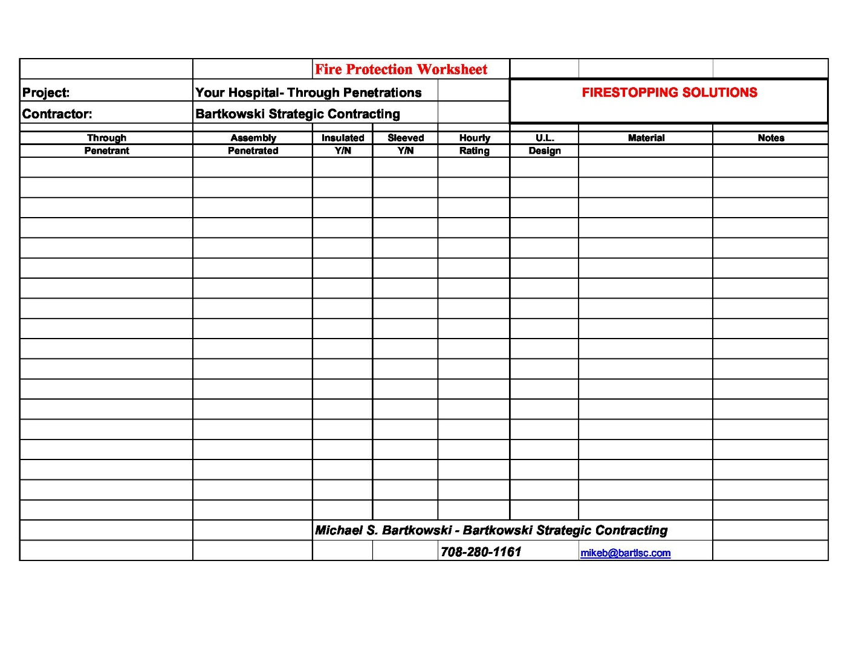

Slide 8
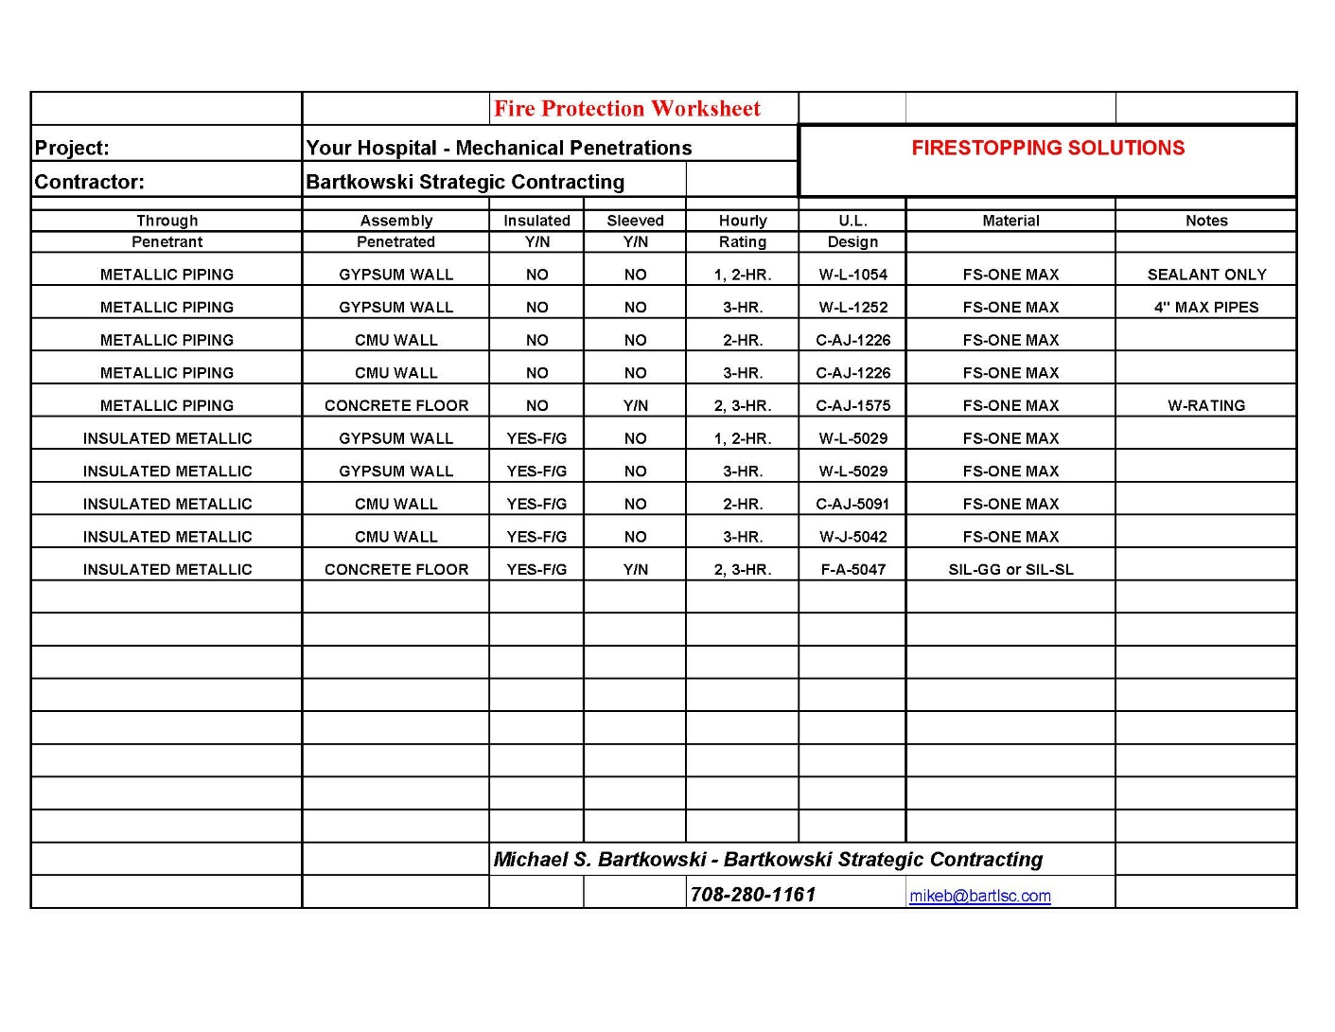

Slide 9
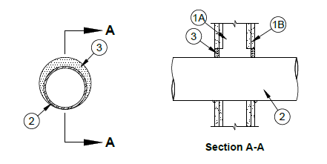
ANSI/UL1479 (ASTM E814) | CAN/ULC S115
F Ratings - 1 and 2 Hr (See Item 1) | F Ratings - 1 and 2 Hr (See Item 1)
T Rating - 0 Hr | FT Rating - 0 Hr
L Rating At Ambient - Less Than 1 CFM/sq ft | FH Ratings - 1 and 2 Hr (See Item 1)
L Rating At 400 F - Less Than 1 CFM/sq ft | FTH Rating - 0 Hr
 | L Rating at Ambient - Less Than 5.1 L/S/m2
 | L Rating at 204°C - Less Than 5.1 L/S/m2
UL Design W-L-1049

Slide 10
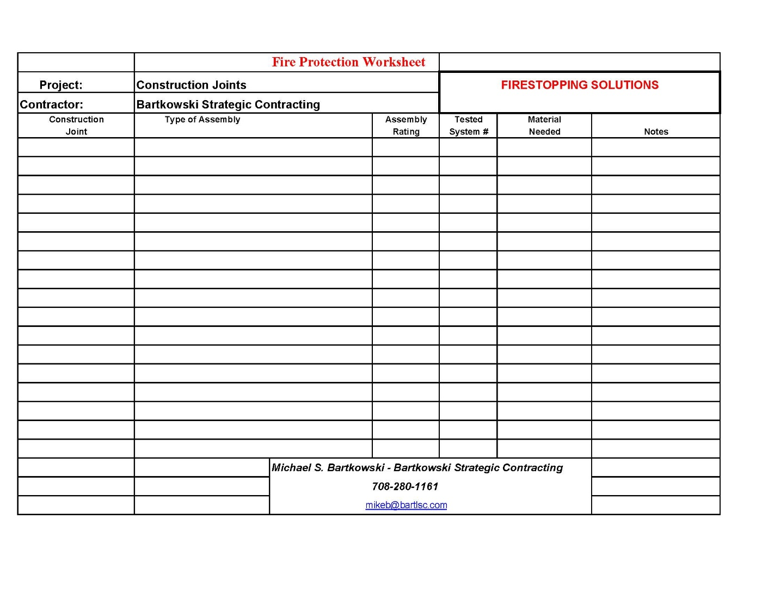

Slide 11
Recommended Holes Sizes for Metallic Pipe and Conduit to Provide Correct Annular Space for UL System Requirements
Pipe Sizes |  | Hole Sizes for non-insulated Pipe |  | Hole Sizes for Pipe with 1" of Insulation |  |  | Hole Sizes for Pipe with 2" of Insulation
Pipe Trade Size | Actual Pipe O.D. | Recommended Min. Hole Size | Recommended Max. Hole Size | Actual Pipe Size with Insulation | Recommended Min. Hole Size | Recommended Max. Hole Size | Actual Pipe Size with Insulation | Recommended Min. Hole Size | Recommended Max. Hole Size
0.5" | 0.840 | 1.50 | 2.50 | 2.84 | 3.50 | 4.50 | 4.84 | 5.50 | 6.50
1.0" | 1.320 | 2.50 | 3.00 | 3.32 | 4.50 | 5.00 | 5.32 | 6.50 | 7.00
1.5" | 1.900 | 3.00 | 3.50 | 3.90 | 5.00 | 5.50 | 5.90 | 7.00 | 7.50
2.0" | 2.375 | 3.50 | 4.00 | 4.38 | 5.50 | 6.00 | 6.38 | 7.50 | 8.00
2.5" | 2.875 | 4.00 | 4.50 | 4.88 | 6.00 | 6.50 | 6.88 | 8.00 | 8.50
3.0" | 3.500 | 4.50 | 5.50 | 5.50 | 6.50 | 7.50 | 7.50 | 8.50 | 9.50
3.5" | 4.000 | 5.00 | 6.00 | 6.00 | 7.00 | 8.00 | 8.00 | 9.00 | 10.00
4.0" | 4.500 | 5.50 | 6.50 | 6.50 | 7.50 | 8.50 | 8.50 | 9.50 | 10.50
6.0" | 6.625 | 7.50 | 8.50 | 8.63 | 9.50 | 10.50 | 10.63 | 11.50 | 12.50
8.0" | 8.625 | 9.50 | 10.50 | 10.63 | 11.50 | 12.50 | 12.63 | 13.50 | 14.50
10.0" | 10.750 | 12.00 | 12.75 | 12.75 | 14.00 | 14.75 | 14.75 | 16.00 | 16.75
12.0" | 12.750 | 14.00 | 14.75 | 14.75 | 16.00 | 16.75 | 16.75 | 18.00 | 18.75
24.0" | 24.000 | 25.00 | 26.00 | 26.00 | 27.00 | 28.00 | 28.00 | 29.00 | 30.00
36.0" | 36.000 | 37.00 | 38.00 | 38.00 | 39.00 | 40.00 | 40.00 | 41.00 | 42.00

Slide 12
Other Key Points we will address – certainly not all-encompassing but should be part of your PCRA for Firestopping
Treatment of Smoke Barriers versus Smoke Partitions
The ’No Fly Zone’ at Head of Wall Treatments
Structural Beams incorporated into the Head of Wall Joint
Putty Pads and Recessed Cabinets in rated gypsum barriers
Low Voltage Cable Penetrations – Future -Proof your facility
Head of Wall treatments at Gypsum Shaft Liners

Slide 13
SMOKE BARRIERS VS. SMOKE PARTITIONS
A Smoke Barrier is intended to stop the spread of fire and smoke from one area to another and the materials used to construct it will have a designated fire rating of their own. Smoke partitions are not necessarily fire-resistant and are primarily used to stop the spread of smoke only.
All Model Codes require Fire & Smoke Protection
Fire Barriers – Third Party Tested Systems
  Penetrations – UL 1479
  Construction Joints – UL 2079
Smoke Barriers – Third Party Tested Systems
  Minimum 1-hour ‘F-Rating’
  ‘L-Rating’ required
Smoke Partitions – Seal gaps asnd openings with approved materials

Slide 14
ANSI/UL1479 (ASTM E814) | CAN/ULC S115
F Ratings - 1 and 2 Hr (See Item 1) | F Ratings - 1 and 2 Hr (See Item 1)
T Rating - 0 Hr | FT Rating - 0 Hr
L Rating At Ambient - Less Than 1 CFM/sq ft | FH Ratings - 1 and 2 Hr (See Item 1)
L Rating At 400 F - Less Than 1 CFM/sq ft | FTH Rating - 0 Hr
 | L Rating at Ambient - Less Than 5.1 L/S/m2
 | L Rating at 204°C - Less Than 5.1 L/S/m2
UL Design W-L-1049

Slide 15
NO FLY ZONE
T-Rating- Usually expressed in hours indicating the length of time the temperature on the non-fire (cold) side of the rated assembly does not exceed 325 degrees F.
Penetrations in Fire rated horizontal assemblies shall have a ‘T-Rating’ not less than 1-hour, and not less than the fire – resistance rating of the horizontal assembly.

Slide 16
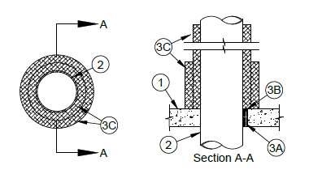
ANSI/UL1479 (ASTM E814) | CAN/ULC S115
F Rating - 2 Hr | F Rating - 2 Hr
T Ratings - 1-1/2, 1-3/4 and 2 Hr (See Item 2) | FT Ratings - 1-1/2, 1-3/4 and 2 Hr (See Item 2)
L Rating At Ambient - Less Than 1 CFM/sq ft | FH Rating - 2 Hr
L Rating At 400 F - Less Than 1 CFM/sq ft | FTH Ratings - 1-1/2, 1-3/4 and 2 Hr (See Item 2)
W Rating - Class 1 (See Item 3B) | L Rating At Ambient Less Than 5.1 L/s/m2
 | L Rating At 204 C Less Than 5.1 L/s/m2
UL Design F-A-1093

Slide 17
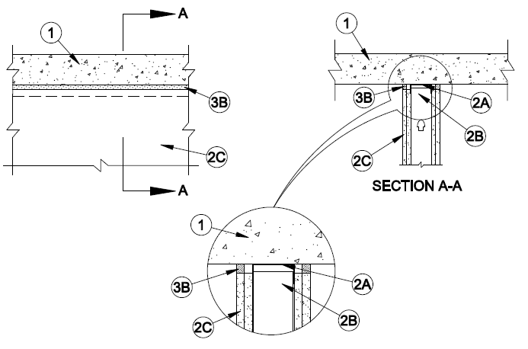
Assembly Ratings - 1 & 2 Hr
Joint Width - 3/4 in. Maximum
L Rating At Ambient - Less Than 1 CFM/Lin Ft
L Rating At 400°F - Less Than 1 CFM/Lin Ft
Class II Movement Capabilities - 25% Compression
UL Design HW-D-0079

Slide 18
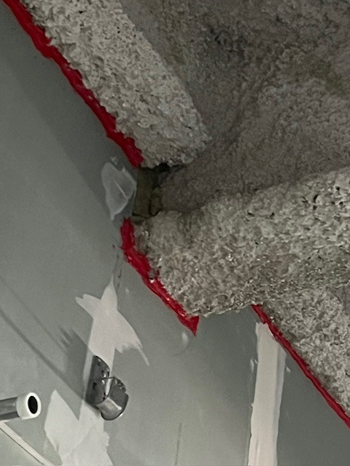

Slide 19
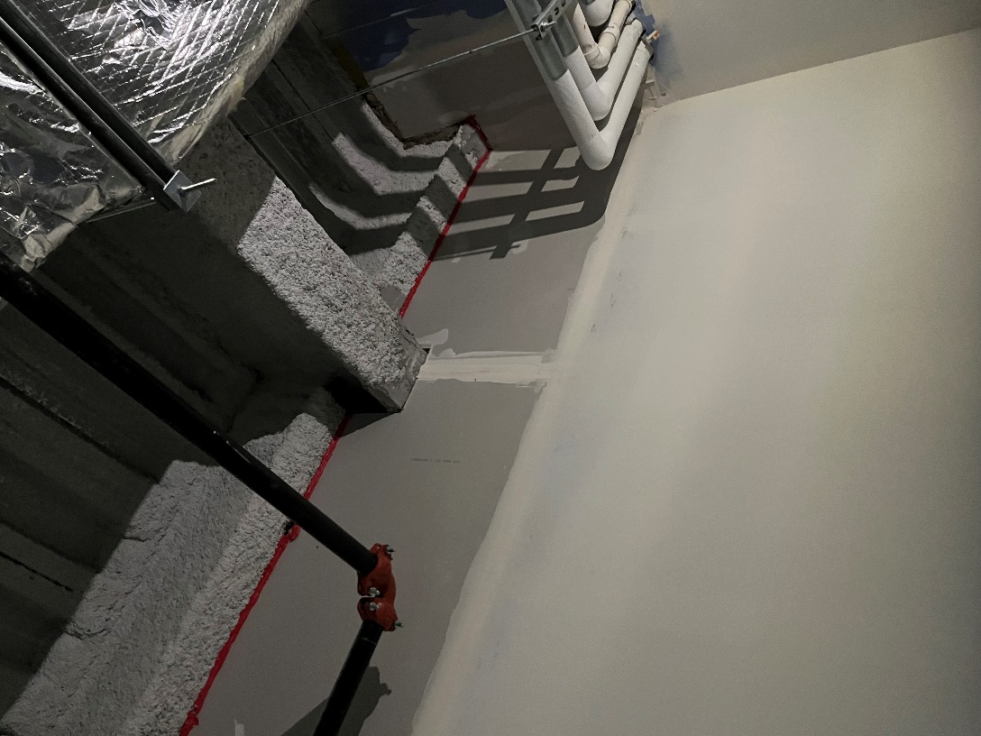

Slide 20
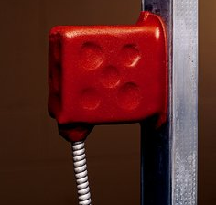
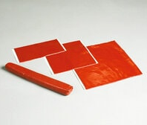

Putty pads are designed to be applied to the internal/external surfaces of metallic and nonmetallic switch and receptacle boxes in some rated wall conditions. It also used in a few systems for through-penetrations.

Slide 21
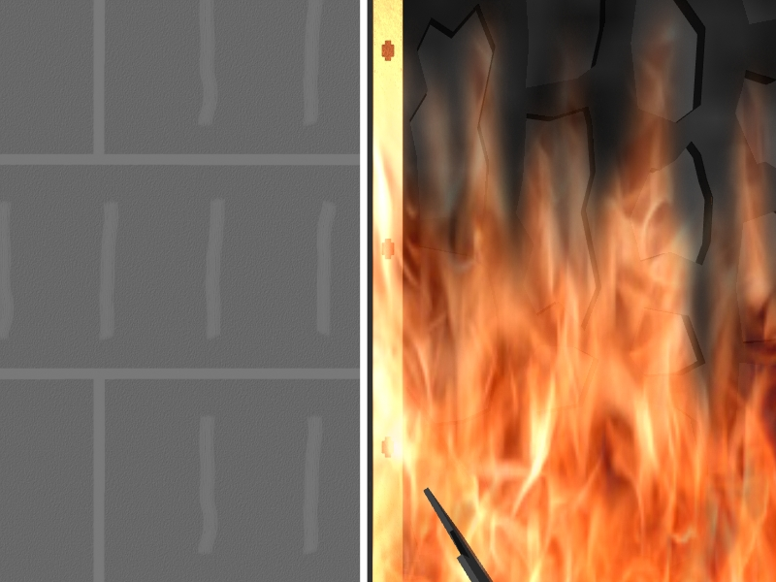

Slide 22
Low Voltage Cable Penetrations
Plastic jacketed cable are fuel
# 1 Through Penetration Violation in Hospital Facilities

Slide 25
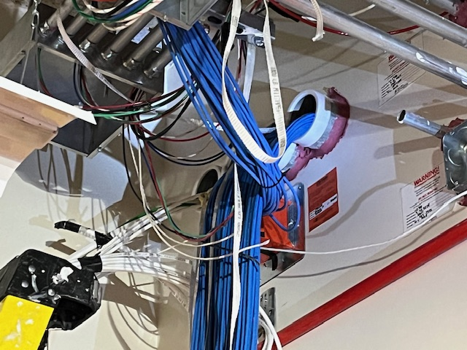

Slide 26
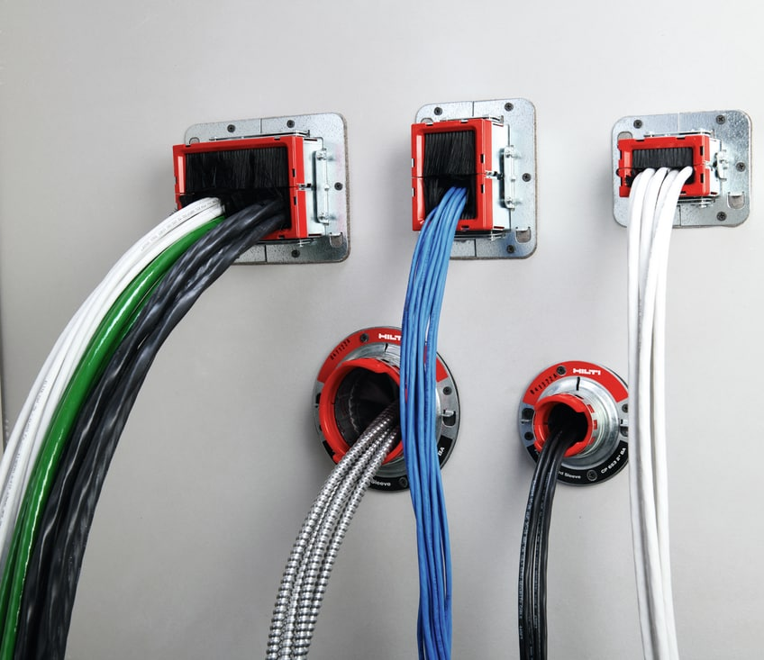
Hilti’s and STI’s raceway device
Low Voltage Cable Penetrations – Eliminate the maintenance headache by treating them with zero maintenance devices.

Slide 27
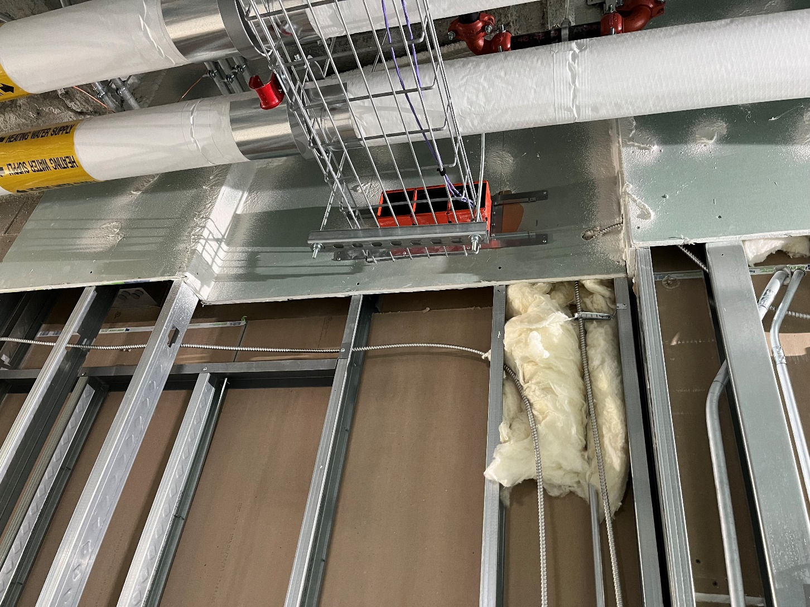

Slide 28
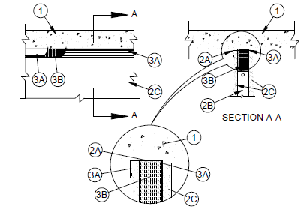
HEAD OF WALL TREATMENT FOR SHAFT LINER
ANSI/UL2079 | CAN/ULC S115
Assembly Ratings - 1 and 2 Hr (See Item 2) | F Ratings - 1 and 2 Hr (See Item 2)
Nominal Joint Width - 3/4 in. | FT Ratings - 1 and 2 Hr (See Item 2)
Class II or III Movement Capabilities - 100% Compression (See Item 3) | FH Ratings - 1 and 2 Hr (See Item 2)
L Rating at Ambient - Less Than 1 CFM/Lin Ft | FTH Ratings - 1 and 2 Hr (See Item 2)
L Rating at 400°F - Less Than 1 CFM/Lin Ft | Nominal Joint Width - 19 mm
 | Class II or III Movement Capabilities - 100% Compression (See Item 3)
 | L Rating at Ambient - Less Than 1 CFM/Lin Ft
 | L Rating at 400°F - Less Than 1 CFM/Lin Ft
UL Design HW-D-0697

Slide 29
THANK YOU
We want to be your Firestopping Resource
+708-498-0004
www.bartlsc.com
info@bartlsc.com
140 W 168th St South Holland, IL 60473

