Slide 1


WELCOME!

Slide 2


Today’s Agenda
11:30 a.m. - 12:45 p.m. Check-in and Lunch
12:45 p.m. Announcements
Brittany Remec – HESNI President
Ben Stauffer – ISHE President; Ivy Tech Representative
Don Page – Region 5 ASHE Announcements
1 p.m. Speaker 1 – RA Tom Sivak
2:30 p.m. Speaker 2 – John Wandolowski
3:45 p.m. Conclusion and Proceed to Journeyman for Networking Happy Hour

Slide 3




THANK YOU TO OUR SPONSORS
Venue Sponsor
Networking Happy Hour Sponsors

Slide 4
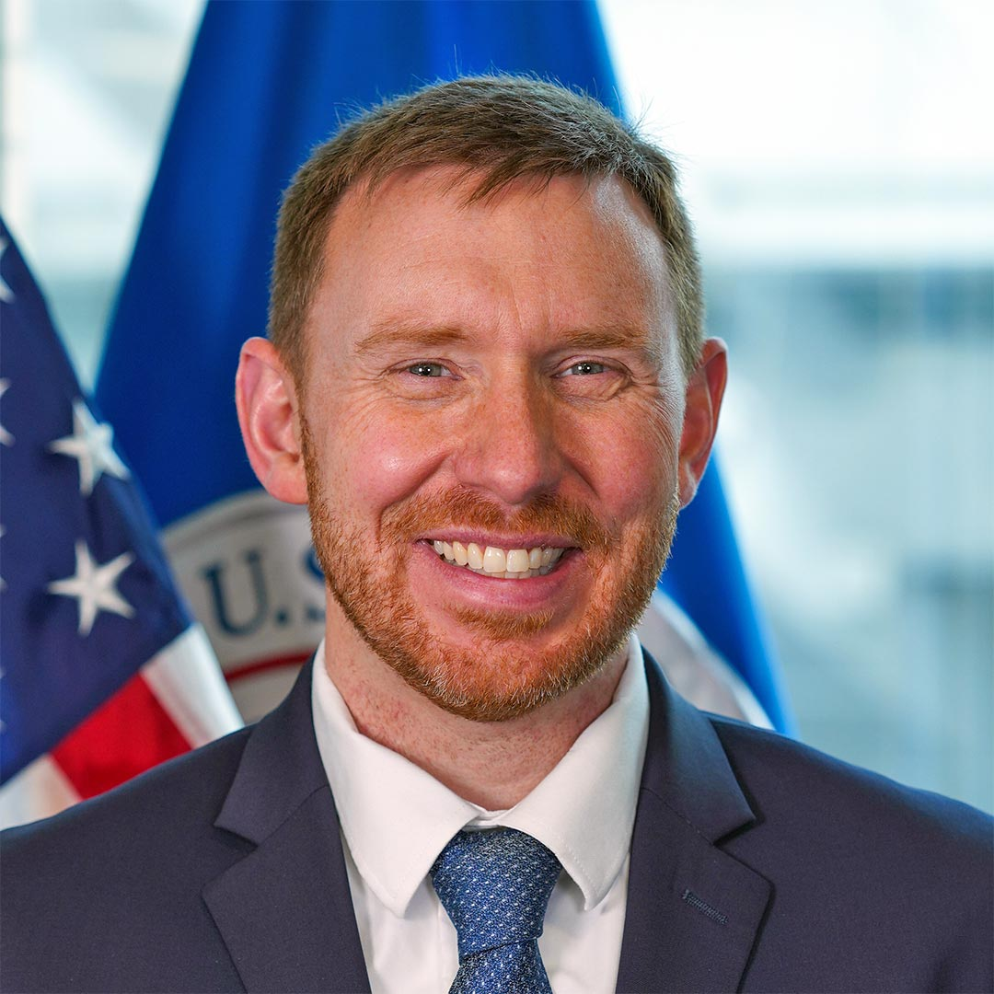
Tom Sivak, FEMA Region 5 Administrator
Tom Sivak will share the agency’s priorities and game-changing actions underway to build nationwide disaster resilience. Emphasizing a proactive approach to emergency management, he will discuss FEMA’s efforts to expand capacity at all levels and ways the agency is working to better position responders and our whole community partners in preparing for and meeting the evolving challenges of the future.

Slide 5
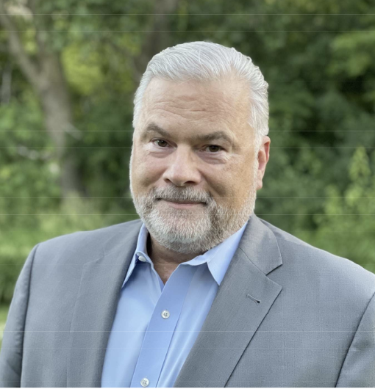
John Wandolowksi, BSE, MBA, CHFM
John Wandolowksi has 30 years of manufacturing, engineering, higher education and healthcare management experience. He will be presenting on “Management By Experience”, which is based on a book he authored, Building Your Leadership Toolbox. Mr. Wandolowksi also is the host of a successful podcast. He will discuss how to prepare for leadership responsibilities, how to improve and build job satisfaction for employees and how to develop trust, listening and communication skills.

Slide 6
THANK YOU!

